Slide 1
Structural Heart Live Case #1 : AM, 82 YO F
Presentation: Progressive fatigue and recurrent syncope with fall, which found to have complete heart block and elevated trans AVG
PMH: Severe AS s/p TF-TAVR with 23mmS3-1 cc in 3/2019, Hypothyroidism, HLD, non-obstructive CAD, complete heart block s/p PPM 9/2023, ICH secondary to fall 9/2023
Medications: Lisinopril, amlodipine, levothyroxine, simvastatin
Labs: Hgb 10.3, PLT 281K, K 4.4, Cr 1.04, INR 1.4
EKG: Atrial-sensed, ventricular paced rhythm
TTE: Severe aortic prosthetic stenosis (PG/MG/EOA/PV = 61/36/0.67/3.91) with minimal PVL, LVEF 70%, mild MR
Notes:
8808402

Slide 2
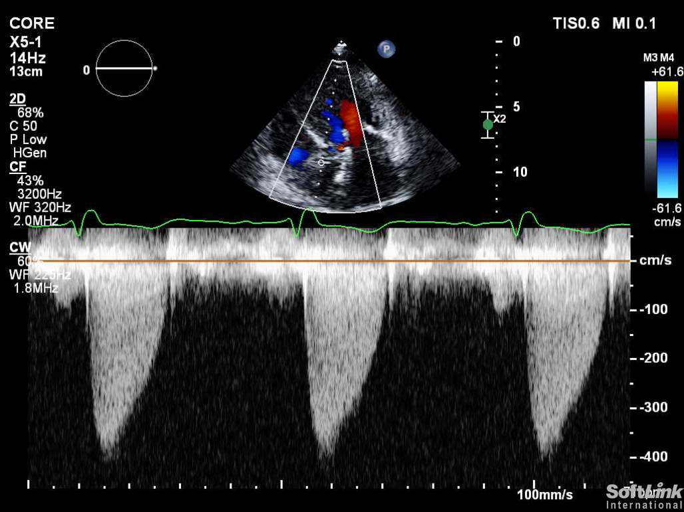
Transthoracic Echocardiogram
thickening noted of the anatomical left coronary leaflet
LVEF 70%, Severely aortic prosthetic stenosis with minimal PVL
PG/MG/EOA/PV = 61/36/0.67/3.91
Notes:
TTE 8/28/23
normal left ventricular size
normal left ventricular systolic function; ejection fraction (2D) = 70%
mildly increased left ventricular wall thickness
normal right ventricular size
normal right ventricular function
abnormal percutaneous aortic prosthesis (balloon-expandable: 23 mm Edwards Sapien
3) (abnormal due to stenosis); minimal paravalvular aortic regurgitation; peak velocity
= 3.91 m/s; peak gradient = 61 mmHg; mean gradient = 36 mmHg; velocity ratio = 0.23;
effective orifice area (EOA) by VTI = 0.67 cm^2
thickening noted of the anatomical left coronary leaflet
mild transvalvular aortic regurgitation
minimal valvular mitral regurgitation
mild tricuspid regurgitation
no evidence for pulmonary hypertension
no evidence for pericardial effusion

Slide 3
Transesophageal Echocardiogram
Restricted and thickened functional noncoronary & right coronary cusps of TAVR due to valve degeneration
Notes:
abnormal percutaneous aortic prosthesis (balloon-expandable: 23 mm Edwards Sapien
3) (abnormal due to stenosis, regurgitation); no evidence for paravalvular aortic
regurgitation; peak velocity = 3.34 m/s; peak gradient = 45 mmHg; mean gradient = 22
mmHg; velocity ratio = 0.22; effective orifice area (EOA) by VTI = 0.69 cm^2; EOAI =
0.47 cm^2/m^2
restricted and thickened functional noncoronary and right coronary cusps of TAVR due
to valve degeneration.

Slide 4
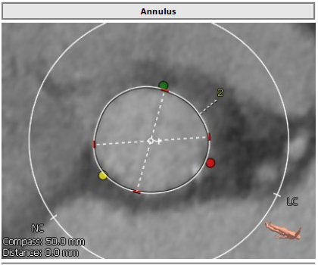
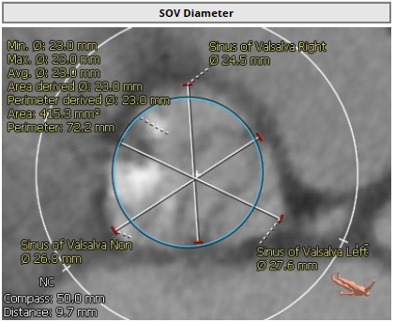
Previous TAVR in 2019
Aortic anulus
Min Ø: 20.3 mm
Max Ø: 22.2 mm
Average Ø: 21.2 mm
LM Ht 10.2
RCA Ht 12.4
23 mm Sapien3 valve – 1cc with LM protection with coronary wire
Notes:
VL 3.0 guide
RCA Ht 12.4
Aortic anulus
Min Ø: 20.3 mm
Max Ø: 22.2 mm
Average Ø: 21.2 mm

Slide 5
Previous TAVR in 2019
The top of the S3 frame is against the top of the LM
NSP
CRP
Top of S3 leaflets at Top of Commissural Tab
23 mm Sapien3 valve – 1cc with LM protection with coronary wire
NSP = Neo skirt plane
CRP = Coronary risk plane

Slide 6
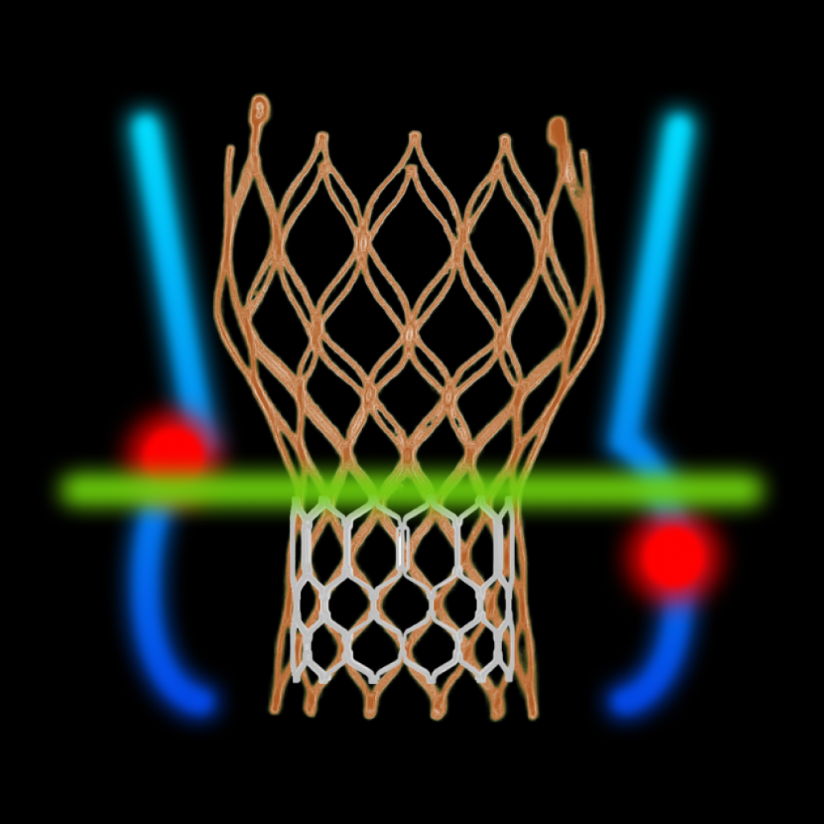
Redo TAV App
Courtesy: M Fukui, V Bapat

Slide 7
Step 1. Index TAV : S3 #23
Outflow
Area/Perimeter measurements
 | Area (mm2) Diameter | Perimeter (mm)
Outflow | 353 (22*21) | 67
Waist | 304 (20*19) | 62
Inflow | 348 (22*20) | 66
Narrowest
Outflow
Narrowest
Inflow
Inflow
Courtesy: M Fukui, V Bapat

Slide 8
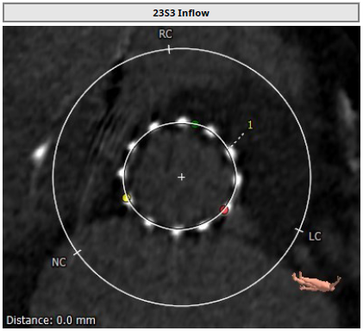
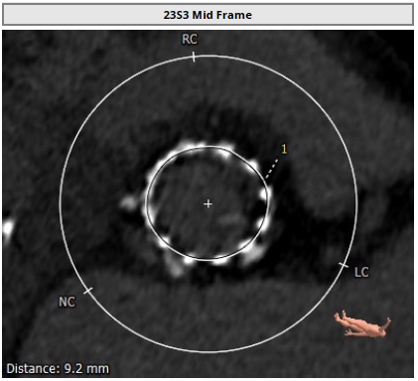
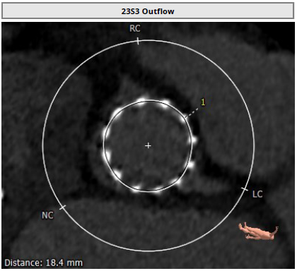
Cardiac CT Analysis Previous TAVR Inflow & Outflow: Underexpanded valve
Inflow of 23mm S3
Max: 22.0 mm
Min: 20.8 mm
Mean: 21.4 mm
Perimeter = 67.2 mm
Area = 359 mm²
Mid Frame of 23mm S3
Max: 20.7 mm
Min: 19.2 mm
Mean: 19.9 mm
Perimeter = 62.4 mm
Area = 309.3 mm²
Outflow of 23mm S3
Max: 21.8 mm
Min: 20.9 mm
Mean: 21.3 mm
Perimeter = 67.2 mm
Area = 359 mm²

Slide 9
Redo TAV App
Courtesy: M Fukui, V Bapat

Slide 10
Step 2. CRP and its relation to index TAV :
CRP defined as below the LOWEST coronary ostia
Bottom of RCA
Bottom of LCA
Bottom of RCA
at Top of commissure tab
Bottom of LCA
~ Top of commissure tab
This case’s CRP ~ at Top of commissure tab
Modified from: M Fukui, V Bapat

Slide 11
Index TAV: 23 mm Sapien 3
Important landmark: Top of Commissure Tab
NSP
Top of commissure tab is where the leaflets end = Neo skirt
CRP
Modified from: M Fukui, V Bapat

Slide 12
Cardiac CT Analysis
NSP
CRP
Narrow VTC to LCA
CRP just below NSP

Slide 13
Redo TAV App
Courtesy: M Fukui, V Bapat

Slide 14
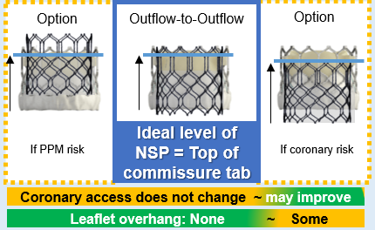
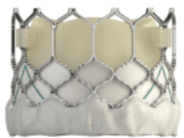
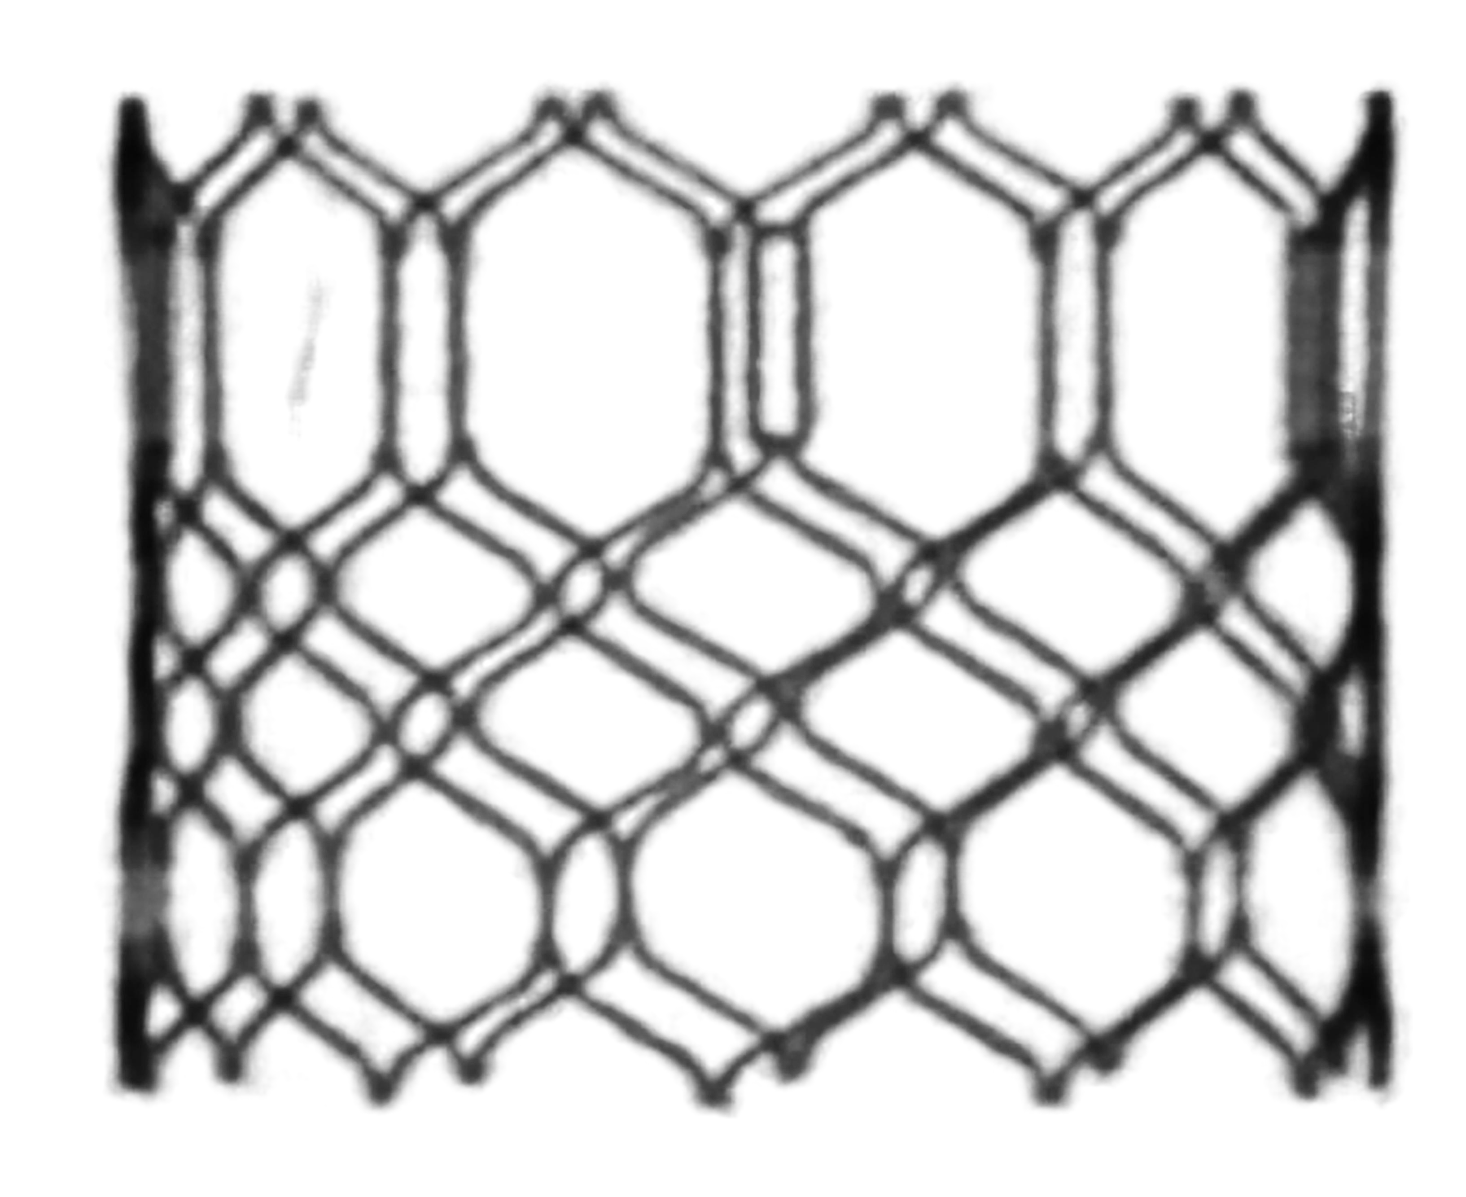
Step 3. Select Second TAV
Step 4. Choose NSP and Assess relation between NSP/CRP
This case:
NSP and CRP nearly same level
NSP at CRP
Near the top of commissure tab
NSP
CRP
Low risk of acute coronary obstruction
Modified from: M Fukui, V Bapat

Slide 15
Redo TAV App
Courtesy: M Fukui, V Bapat

Slide 16
Step 5. Second TAV Sizing
 | Area (mm2) | Perimeter (mm)
Outflow | 353 | 67
Waist | 304 | 62
Inflow | 348 | 66
→ Average area: 335 mm²
Average perimeter: 65 mm
BSA = 1.51 m²
S3 #20: 0.81 cm²/m² (mod PPM)
S3 #23: 0.96 cm²/m² (no PPM)
IFU for S3
Valve size | Area (mm²) | Area derived diameter (mm)
20 | 273-345 | 18.6-21
23 | 338-430 | 20.7-23.4
26 | 430-546 | 23.4-26.4
29 | 540-683 | 26.2-29.5
→ Second TAV
S3 #20 +1cc vs
S3 #23 -1cc?
Evolut #26
Modified from: M Fukui, V Bapat

Slide 17
Redo TAV App
Courtesy: M Fukui, V Bapat

Slide 18
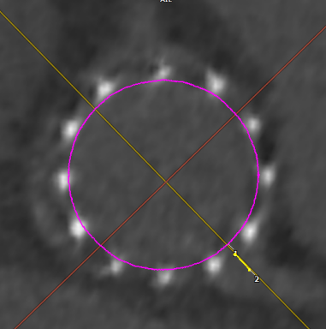
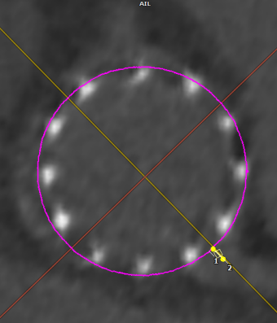
Step 6. Coronary risk assessment
Just in case…
The level of LCA VTC = Top of stent frame
NSP just above CRP for LCA
LCA VTC
NSP
CRP
Just above top of commissure tab
Low risk of acute coronary obstruction
Delayed coronary obstruction?
Difficult coronary access post Redo TAV?
Virtual circle of
#20 #23
VTC = 2.3 mm 1.5 mm
Index 23 S3 further expansion by redo TAV?
Courtesy: M Fukui, V Bapat

Slide 19
Cardiac CT Analysis
Moderate commissural misalignment

Slide 20
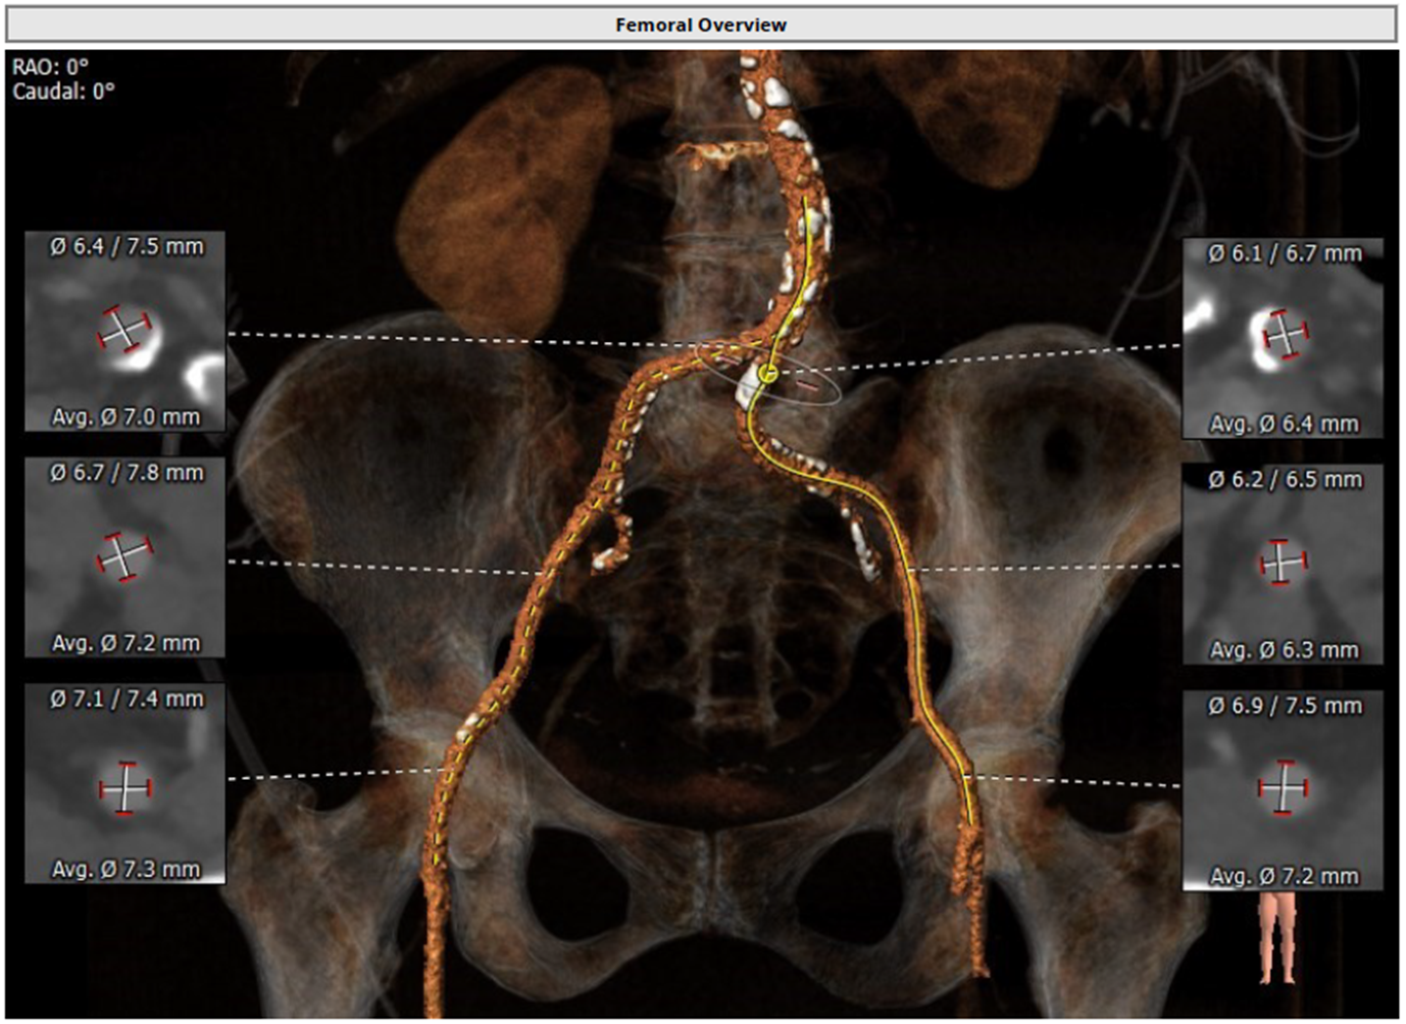
Aorto-Iliac Bifurcation

Slide 21
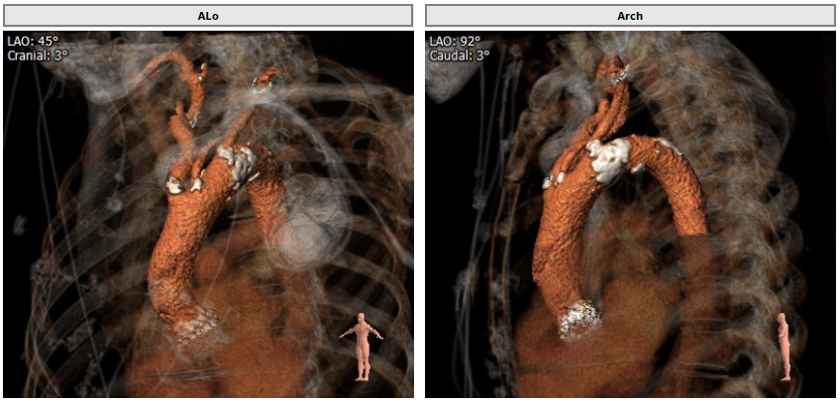
Aortic Arch

Slide 22
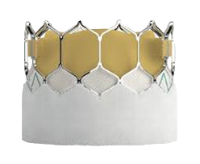
Planned Redo S3 Position
LM protection with guide, stent and wire above or across the index S3 outflow cell
NSP
Top of 23mm S3 just below the index S3 outflow @ ½ cell below

Slide 23
Summary of Case
Presentation: 82 yo F, with recent intracranial hemorrhage, severe aortic prosthetic stenosis, and potential risk of LM occlusion
TTE: severely aortic prosthetic stenosis (PG/MG/EOA/PV = 61/36/0.67/3.91) with minimal PVL, LVEF 70%, mild MR
Risk mortality : high risk for SAVR with previous TAVR for explant
Course: Patient was evaluated by heart team and recommended TF TAV-in-TAV with LM protection
Plan: TF TAV-in-TAV with a 20mm (+1 cc) Sapien3 Ultra Resilia valve after BAV (with 20mm True Balloon) via right percutaneous femoral arterial access with planned LM snorkel stent for coronary access

