Slide 1
Where will Transcatheter Mitral Interventions be in 2030?
Anita W. Asgar MD, MSc, FACC, FSCAI
Medical Director, Structural Heart Program
Montreal Heart Institute

Slide 2
Where will Mitral Valve Disease Therapy be in 2030?
Anita W. Asgar MD, MSc, FACC, FSCAI
Medical Director, Structural Heart Program
Montreal Heart Institute

Slide 3
Disclosures
Anita W. Asgar MD, MSc
Consulting/Honoraria:
Abbott Structural
Medtronic
Edwards Life Sciences
W.L. Gore
Anteris
Research Support:
Abbott Structural

Slide 4
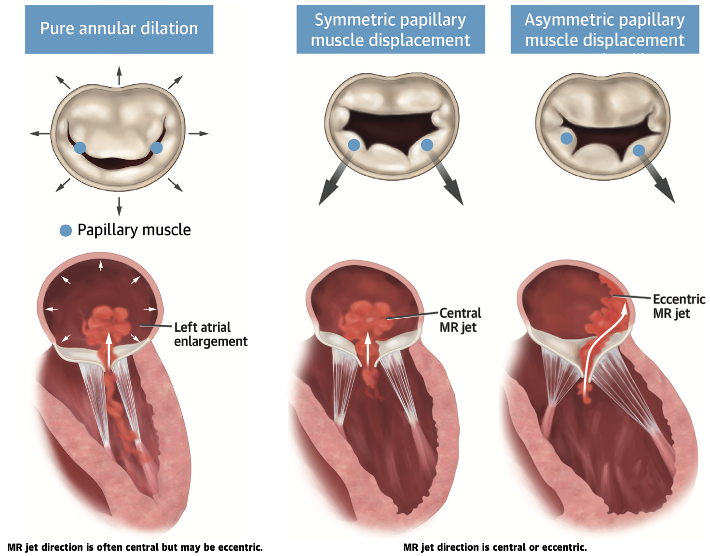
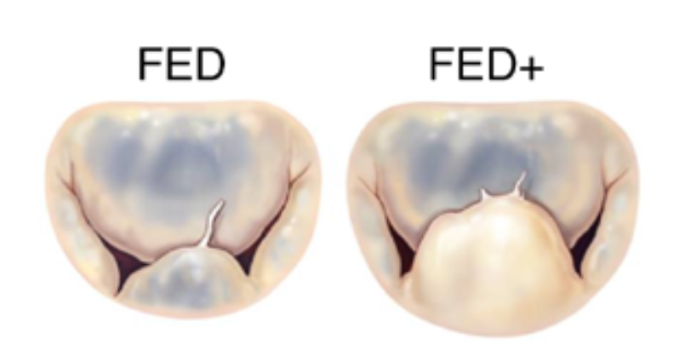
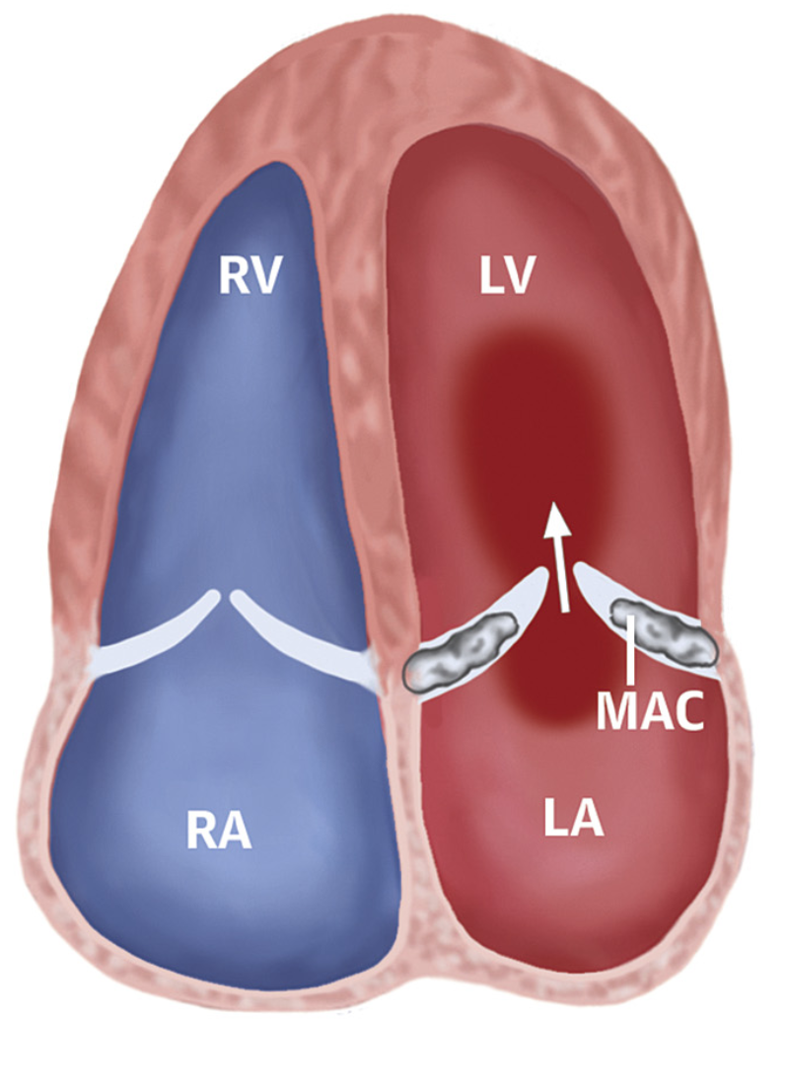
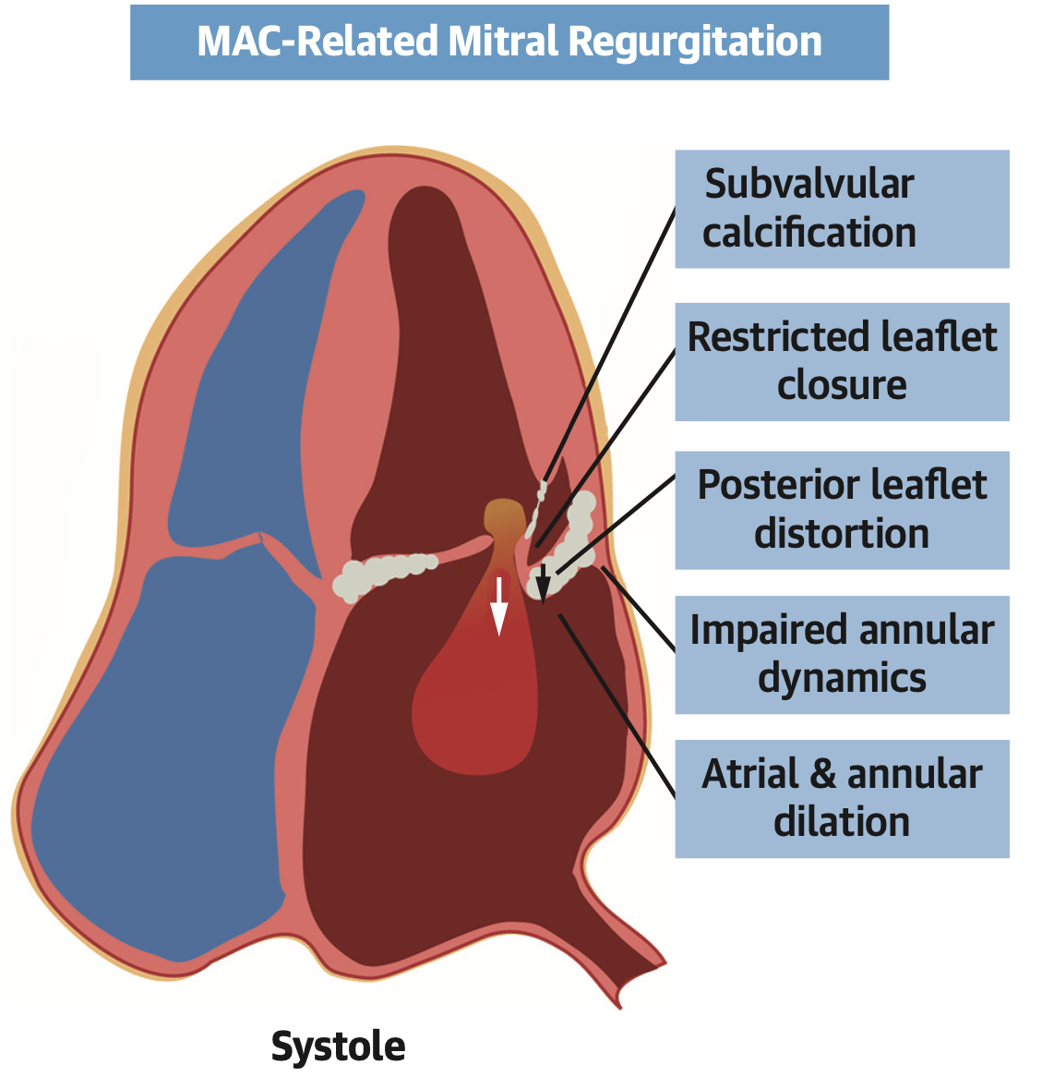
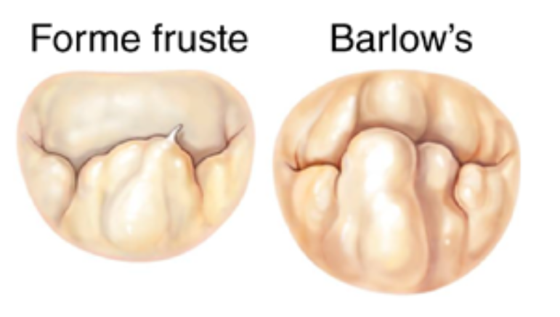
Mitral Valve Disease is …DIVERSE
Secondary MR
Primary MR
Primary MR:
Calcific disease
Atrial
Ventricular
Flail
Prolapse

Slide 5
The PAST(2013)…a window to the Future…
TVT 2013 Slide courtesy of Gregg Stone

Slide 6
The PAST(2013)…a window to the Future…
TVT 2013 Slide courtesy of Gregg Stone

Slide 7

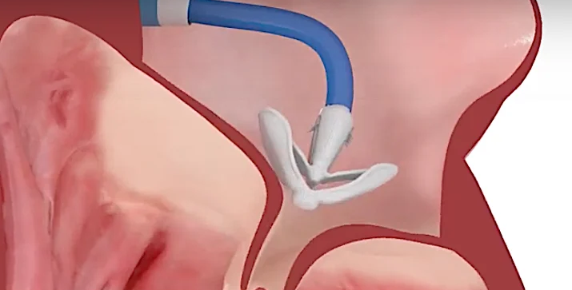
Transcatheter Mitral Interventions:
Where are we in 2023?
Mitral Repair
TEER is the dominant transcatheter mitral repair therapy for primary and secondary mitral regurgitation
  Two approved devices
  Evidence in DMR, FMR
Trials ongoing in Intermediate risk DMR
Chordal repair technologies continuing to develop

Slide 8
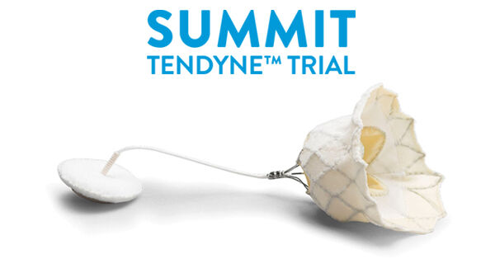
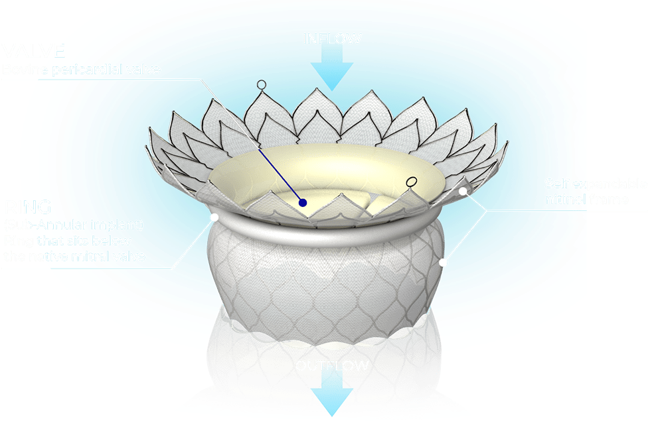
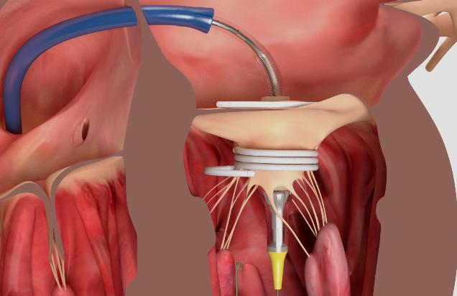
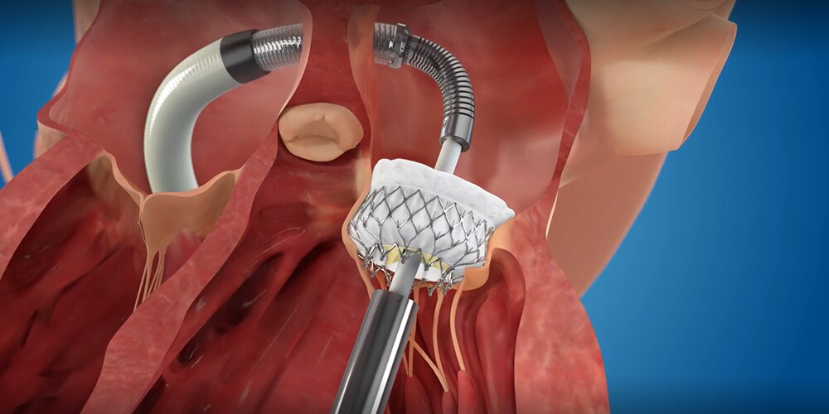
Transcatheter Mitral Interventions:
Where are we in 2023?
Transcatheter Mitral Valve Replacement
  NO Approved devices in North America
  RCT ongoing
  EFS ongoing for multiple devices

Slide 9

Where do we want to GO…2030?

Slide 10
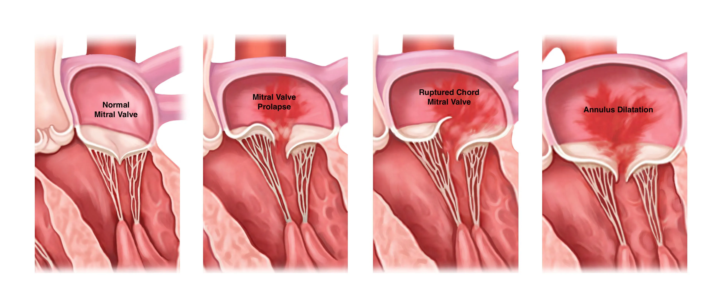
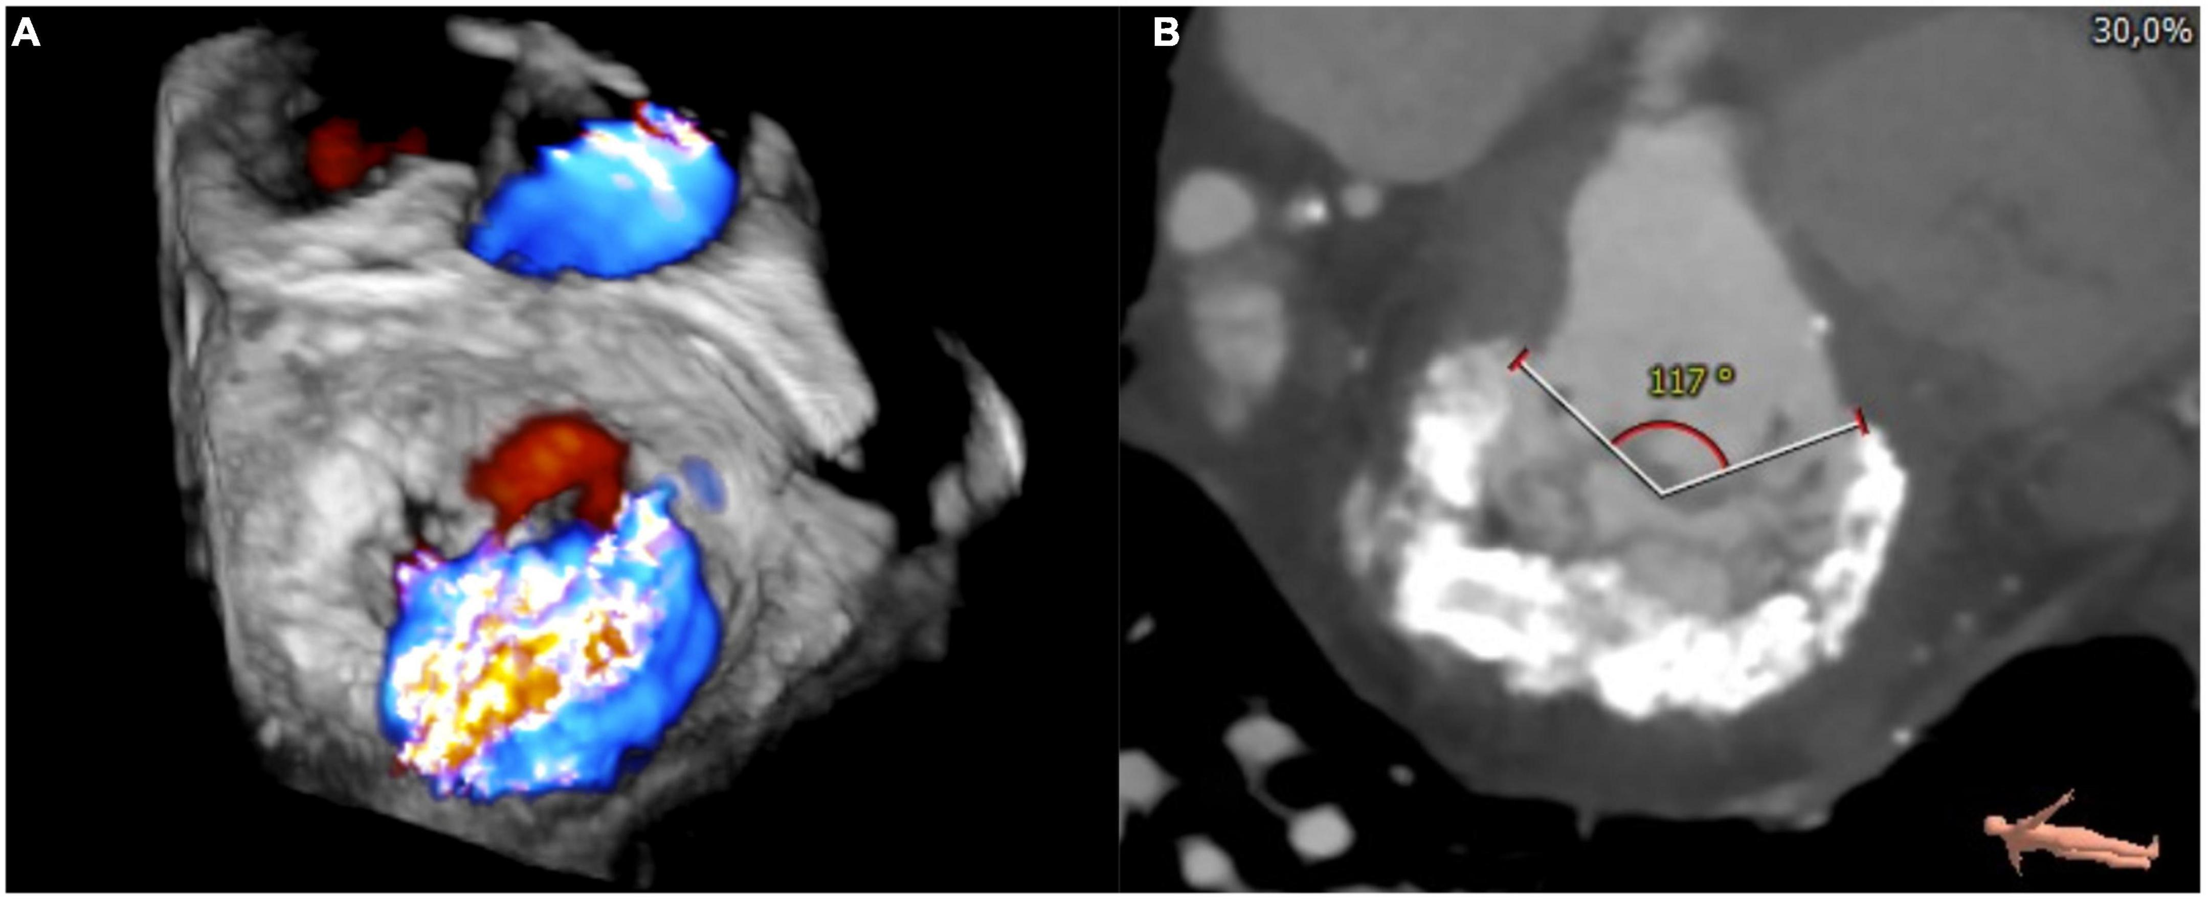
Mitral Valve Disease in 2030
Imaging
Artificial Intelligence
Clinical Decision Making
Timing of Intervention
Therapies
Repair
Replacement

Slide 11

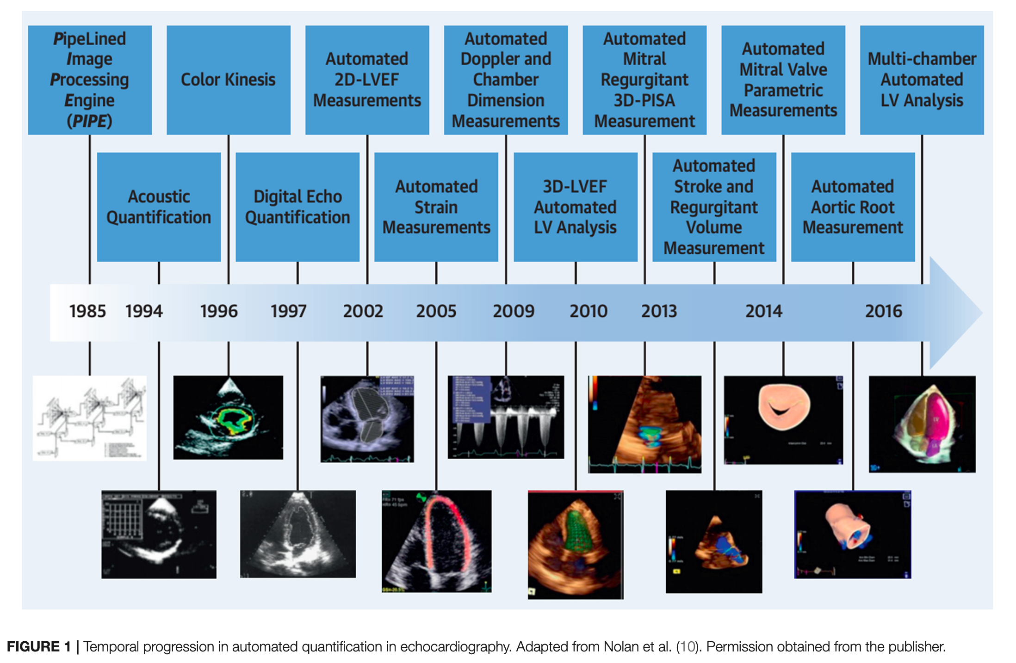
Role of AI in Echocardiography
Notes:
ML algorithms can make new echocardiographic technology clinically relevant. With the emergence of cardiac strain, it can evaluate the cardiac function beyond the ejection fraction. Ejection fraction is hailed as the gold standard metric for cardiac assessment. Although strain can fundamentally alter clinical care, it has not occurred due to the cumbersome and time-consuming nature of the approach (35). The integration of ML algorithms can streamline the clinical workflow by automating numerous calculations.

Slide 12
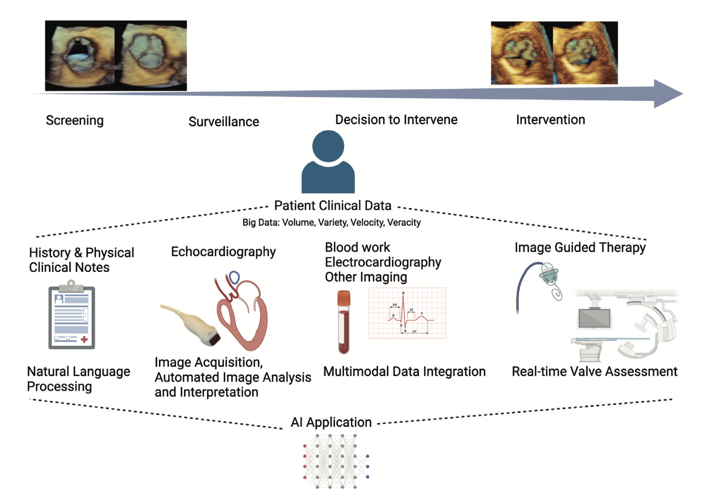
AI to Improve Echo imaging of Valvular Heart Disease
For assessment of VHD, AI can be applied to the following:
Image acquisition
View recognition
Image segmentation
Disease state identification
Nedadur R, et al. Heart 2022;108:1592–1599.

Slide 13
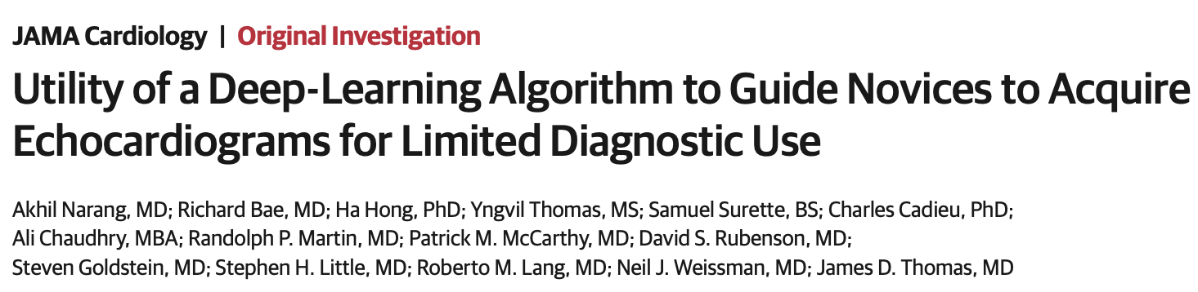
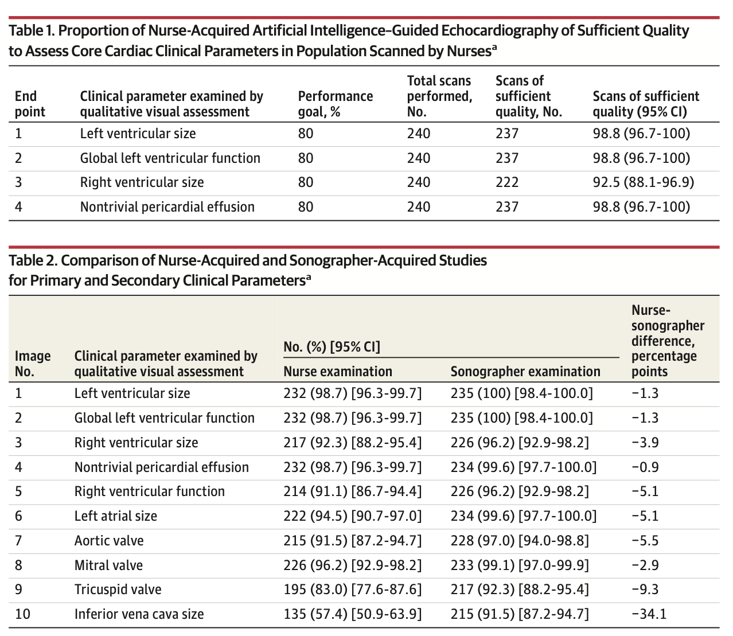
AI to Improve Echo imaging of Valvular Heart Disease
Image acquisition
  Programs to guide image acquisition
View recognition
  Improve valve assessment by identifying data to allow for reading in stacks, automated measurements and guideline criteria
JAMA Cardiol. 2021;6(6):624-632.

Slide 14
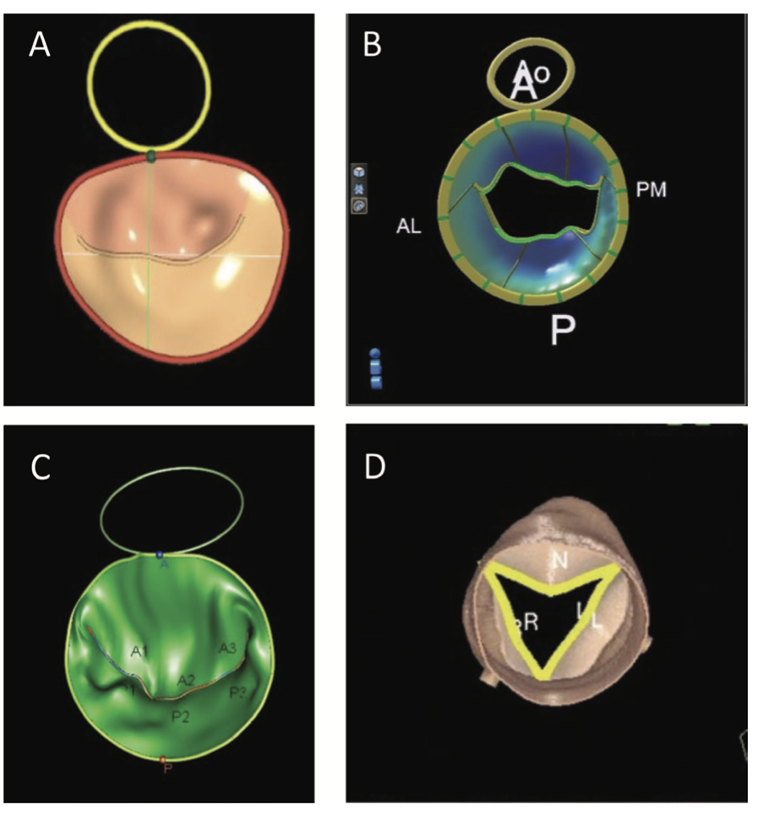
AI to Improve Echo imaging of Valvular Heart Disease
Image Segmentation (Mitral Valve)
  Commercial and non-commercial programs to provide automated valve measures from 3D datasets
Disease State Identification
  DL can automatically encode features from data for recognition that are beyond the scope of human perception
  Moghaddashi et al introduced novel features to detect micro-patterns of echocardiography images in order to determine the severity of MR.
  DL had an accuracy of 99.52%, 99.38%, 99.31% and 99.59%, respectively, for the detection of Normal, Mild MR, Moderate MR and Severe MR subjects among echocardiography videos.
Moghaddasi H, Nourian S. Automatic assessment of mitral regurgitation severity based on extensive textural features on 2D echocardiography videos. Comput Biol Med. 2016 Jun 1;73:47-55.

Slide 15
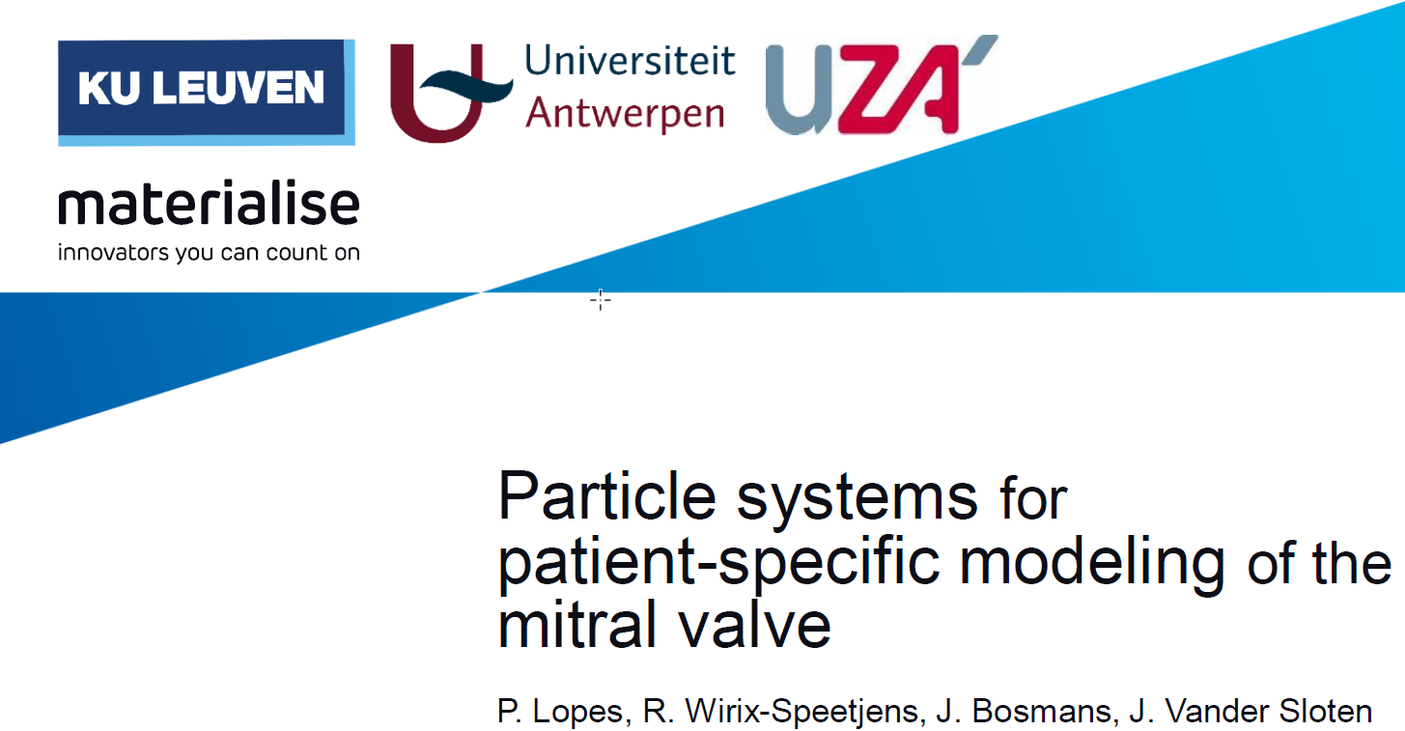
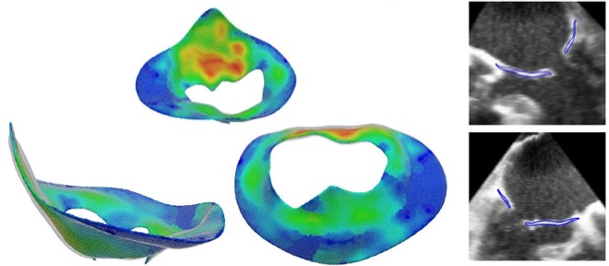

3D Echo segmentation
Example of innovation on 3D Ultrasound segmentation, combining deep learning with traditional segmentation techniques (published in CMBBE)

Slide 16

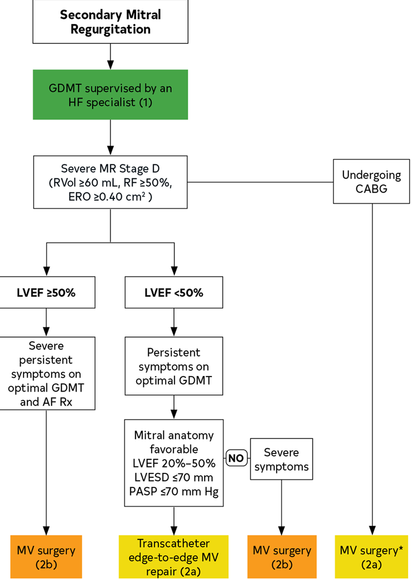
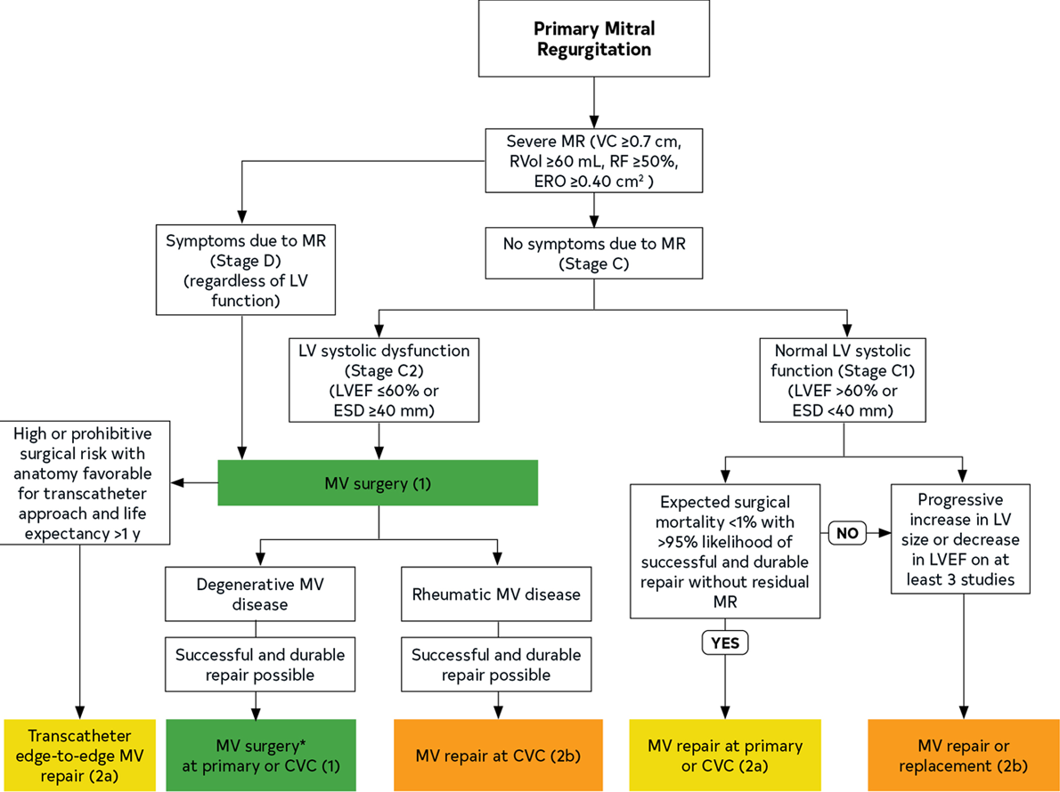
Clinical Decision Making
Current guidelines focus on symptom status and key echo parameters to determine eligibility for intervention.
Advances in imaging and a better understanding of ventricular function using modalities such as MRI and CT scan may provide more insight into optimal timing of intervention for patients.
Utilization of biomarkers and better phenotyping of patients to select appropriate intervention.

Slide 17
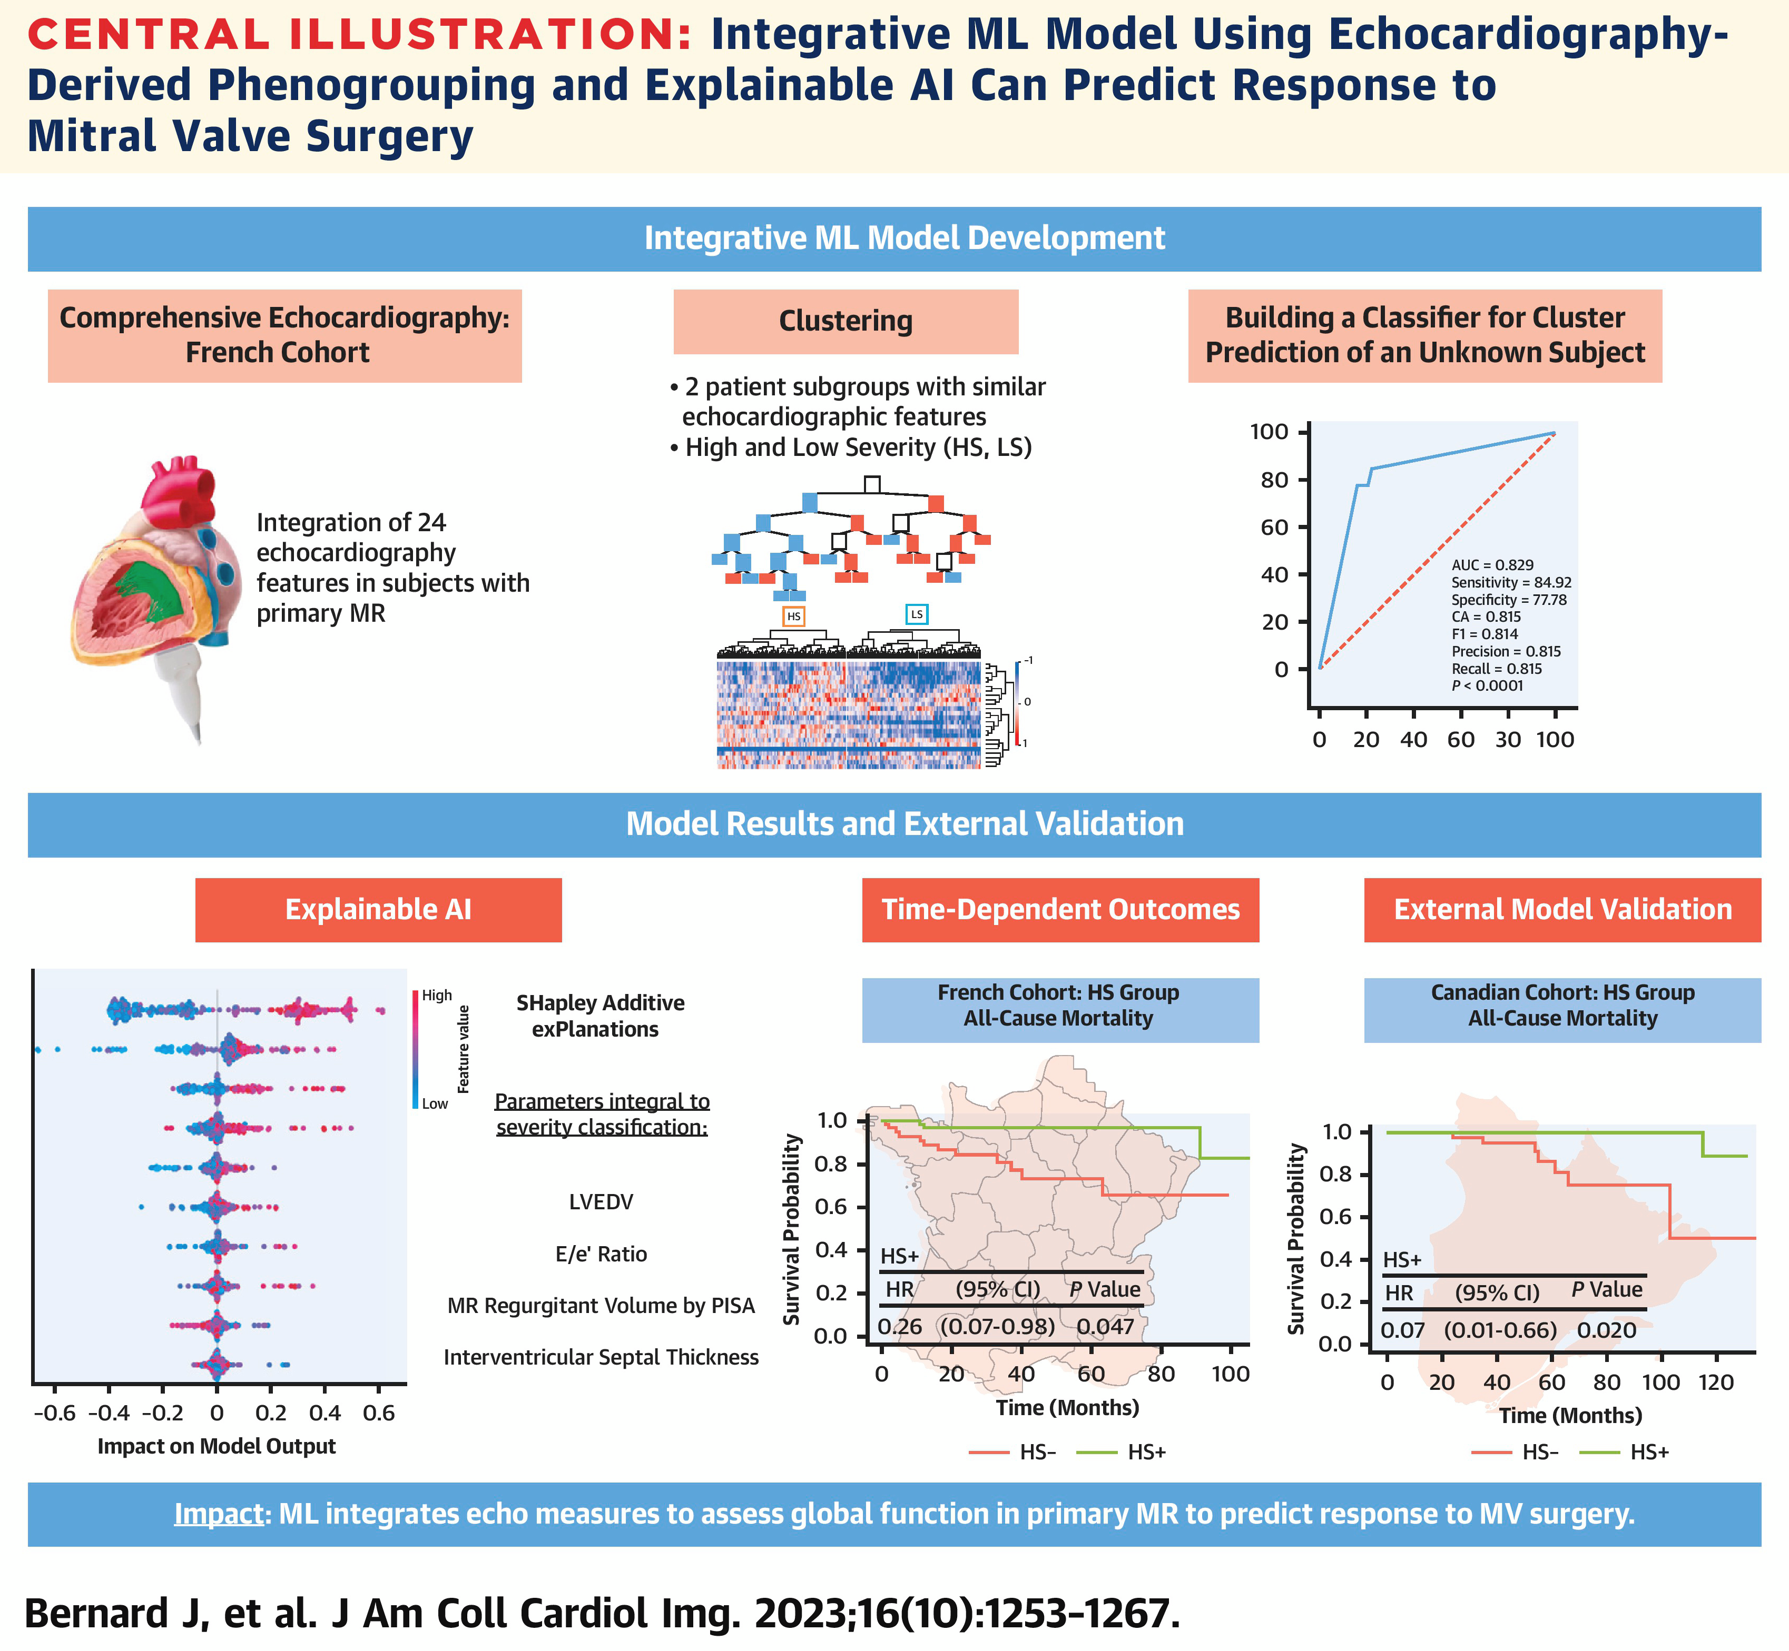
Clinical Decision Making
Machine learning may be able to extract valuable insights from complex echocardiographic data and uncover subgroups within patient populations and reveal connections that traditional statistical techniques cannot identify.
Understanding patients and their unique characteristics may help us understanding the best timing for intervention.

Slide 18

Transcatheter Therapies
The heart team collaboration has led to opportunities for patients to have a more comprehensive approach to treatment options, including surgical repair and the birth of new approaches for mitral annular calcification.
A new understanding on the impact of atrial arrhythmias, particularly AFIB in the development of atrial functional mitral regurgitation, may add EP as an additional member to the heart team.
TEER remains the dominant transcatheter strategy for repair with a better understanding of patient selection in more complex anatomy and outcomes.

Slide 19
In 2023, TMVR is Struggling? And Why?
Anatomic challenges
Sizing
LVOTO (still)…
Inability to treat varying pathologies
Device challenges
Leaflet thrombosis
Need for AC
Elevated gradients
Procedural Challenges
Overly complex devices
Too high risk pts – won’t benefit from durability
(who cares how long it lasts? Pts will die in 2-5 years anyway)
Courtesy of Isaac George, MD

Slide 20
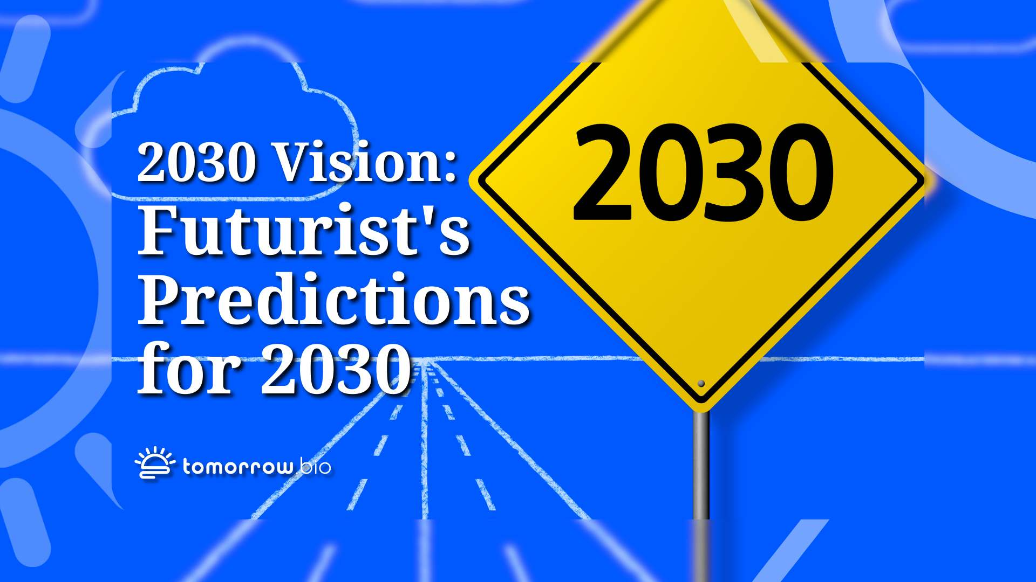
Structural Interventional Cardiologist’s

Slide 21
Mitral Valve Disease Therapy in 2030…
Imaging
Artificial Intelligence
Clinical Decision Making
Timing of Intervention
Therapies
Repair
Replacement
Multimodality Imaging
(TTE, MRI, CT)
Artificial Intelligence for echo screening and device selection
Comprehensive Clinical Decision Making
Timing of Intervention based on multiple parameters including biomarkers
Lifetime Management of Mitral Valve Disease
Ablation
TEER removal
TMVR

Slide 22

My Predictions for 2030…
AI software will evaluate echocardiograms and send automatic referrals for mitral valve disease.
Patients with mitral valve disease will undergo a comprehensive evaluation including extensive biomarkers and multimodality imaging to evaluate the disease stage and indications for intervention.
Society Guidelines will EVOLVE to include more parameters but be broader in determining timing for intervention depending on the risk of the intervention and the patient’s disease stage.

Slide 23
My Predictions for 2030…
AF ablation will be utilized earlier to “PREVENT” Atrial functional MR
TEER will be applied to an even broader patient risk population.
New TMVR devices and techniques (SESAME) will address the high screen fail rates
New TEER removal devices will become available for the lifetime management of patients.

Slide 24

OR Predict the FUTURE!
Thank you for your attention
anita.asgar@umontreal.ca

