Slide 1



Expanding M-TEER Treatable Anatomies: What can our current devices do?
Edwin Ho, MD
Assistant Professor of Medicine
Director, Structural Heart Imaging
Director, Echocardiography Lab
Co-Director, Heart Valve Center
Montefiore Medical Center, New York, USA
Notes:
10 min

Slide 2
Disclosure of Relevant Financial Relationships
Edwin Ho, MD
Within the prior 24 months, I have had a relevant financial relationship(s) with an ineligible company(ies) listed below.
Nature of Financial Relationship | Ineligible Company
Advisor (not reimbursed) | Medtronic, Neochord, Half Moon, VDyne, Valgen, Anteris, Shifamed
Consultant (institutional contract, not directly reimbursed) | GE, Edwards Lifesciences, Abbott
Research grant/support | Philips

Slide 3
Outline
Anatomic “suitability” for M-TEER
Case examples
Data on outcomes in suboptimal anatomy
M-TEER unmet needs

Slide 4
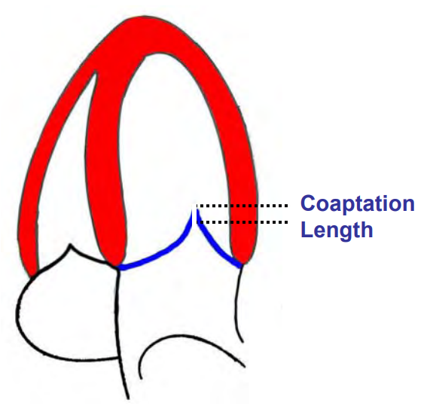
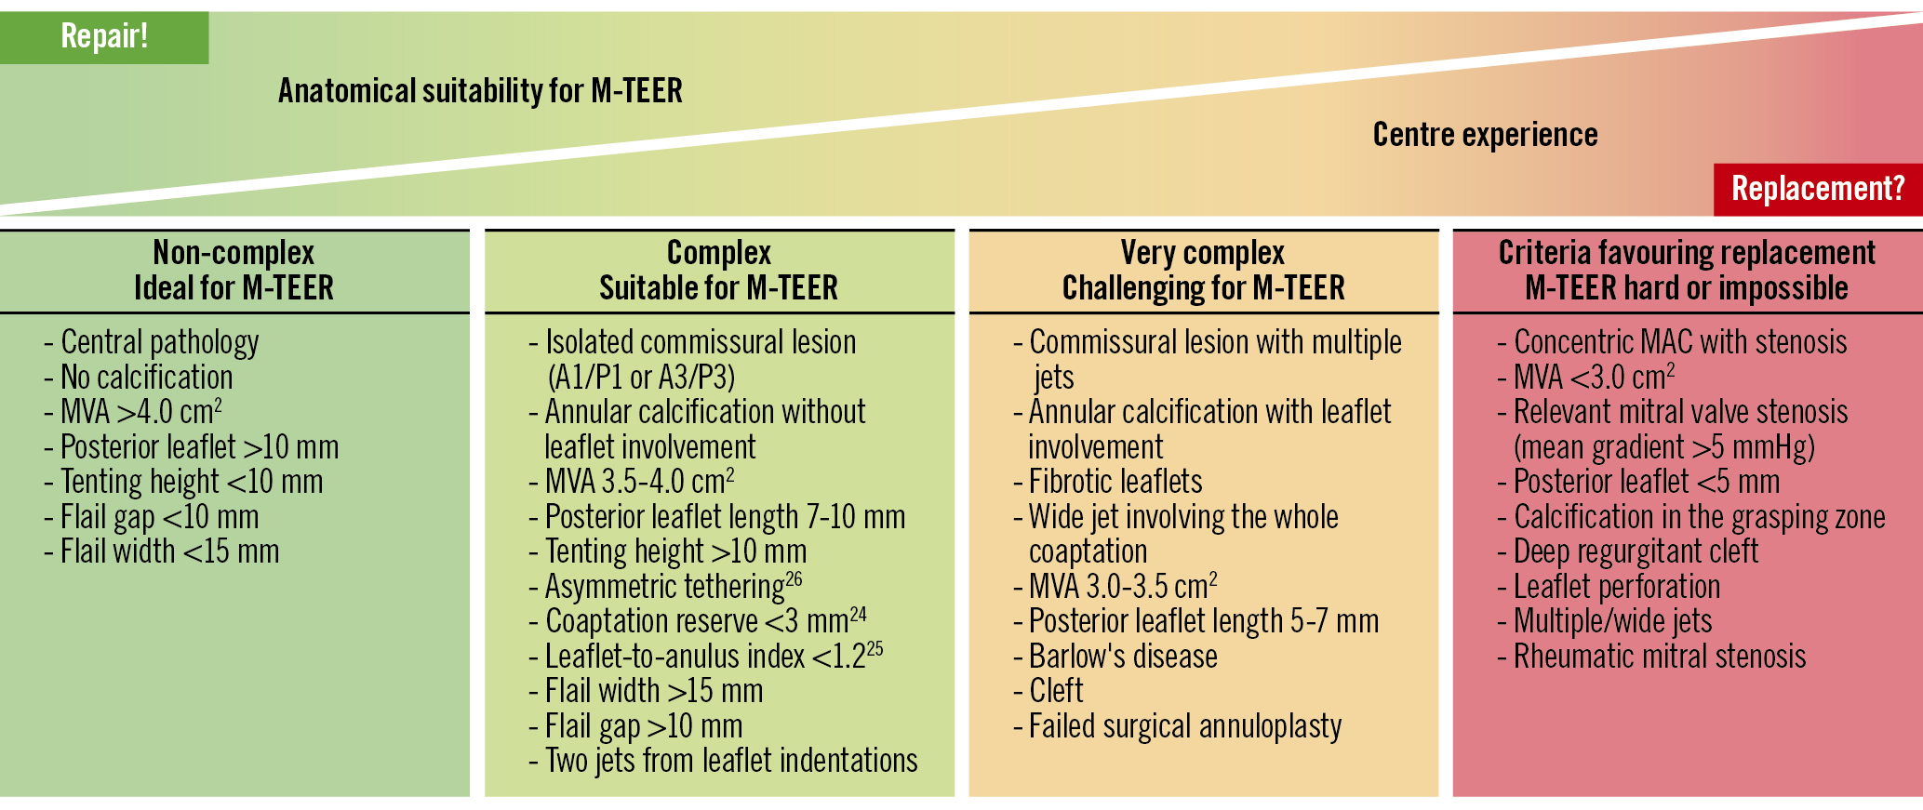
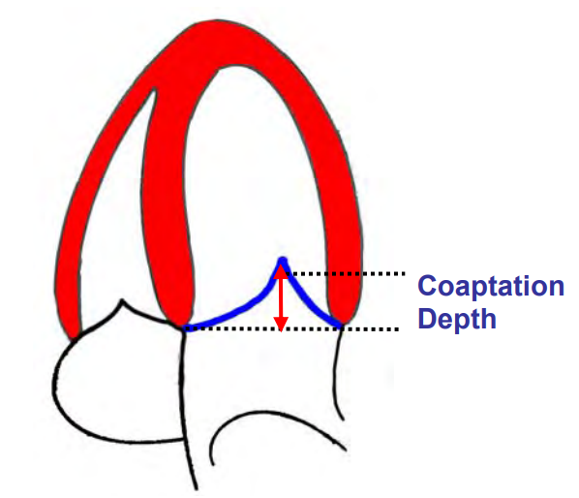
Mitral TEER “suitable” vs “non-suitable”
EVEREST
2023
A2/P2
MVA >4cm2 (2D)
Coaptation depth ≤ 11mm
Coaptation length ≥ 2mm
Hausleiter J, et al., EuroIntervention 2023;18:957
Feldman T, et al. NEJM 2011; 364:1395

Slide 5
Mitral TEER “suitable” vs “non-suitable”
Very good |  | “Ineligible”
Some (less than you would like) | Many | Not many
“Orange”
Who really fits here?

Slide 6
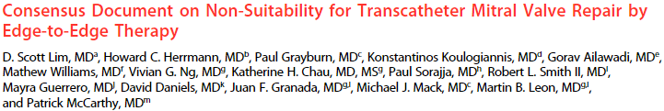
Mitral TEER “suitable” vs “non-suitable”
Structural Heart 2021; 5(3):227
Success risk | Stenosis risk | Other factors
Extreme complexity Free leaflet <5mm Clefts Perforation/endocarditis | Rheumatic/radiation Severe MAC MVA <3.5cm2 | Access Imaging

Slide 7
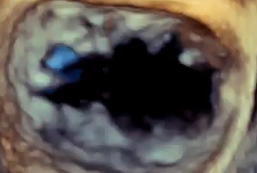
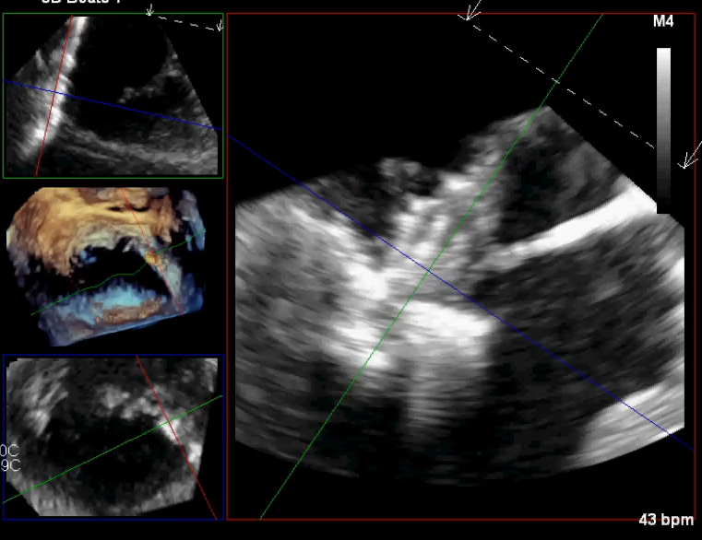
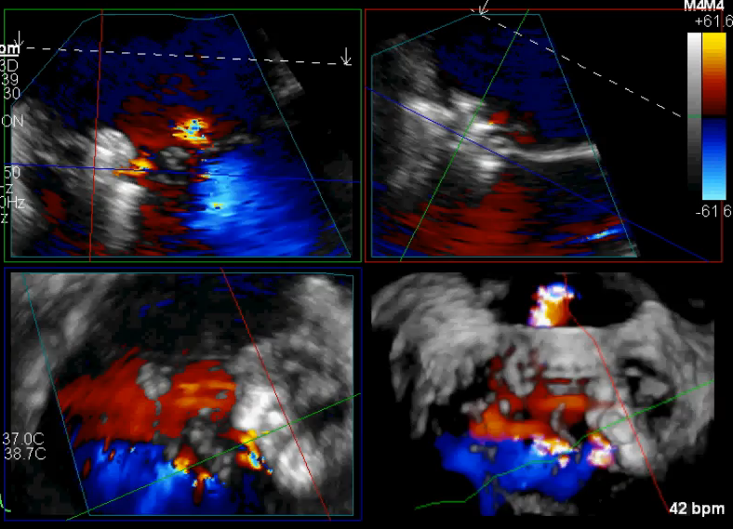
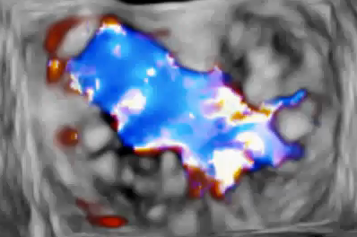
Commissural lesions

Slide 8
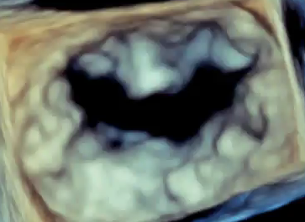
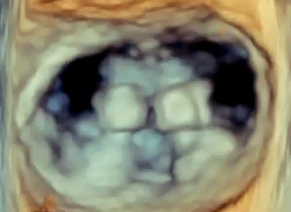
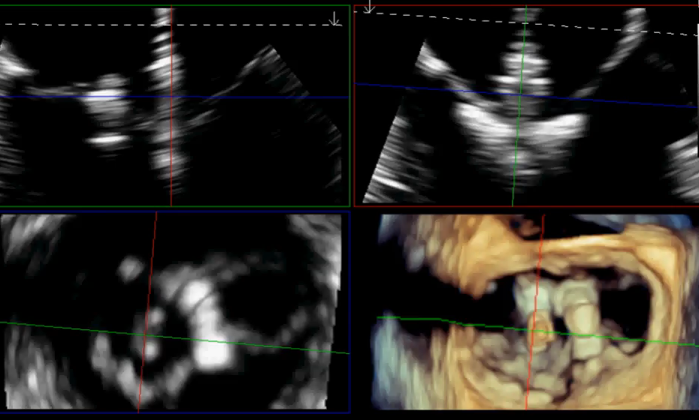
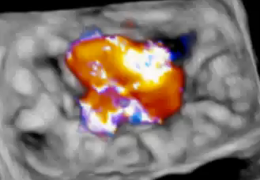
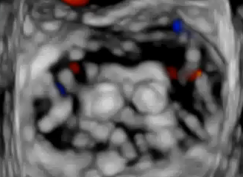
Split/multiple jets

Slide 9
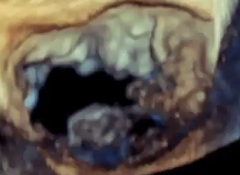
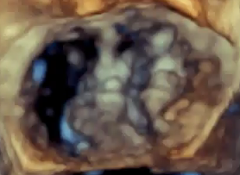
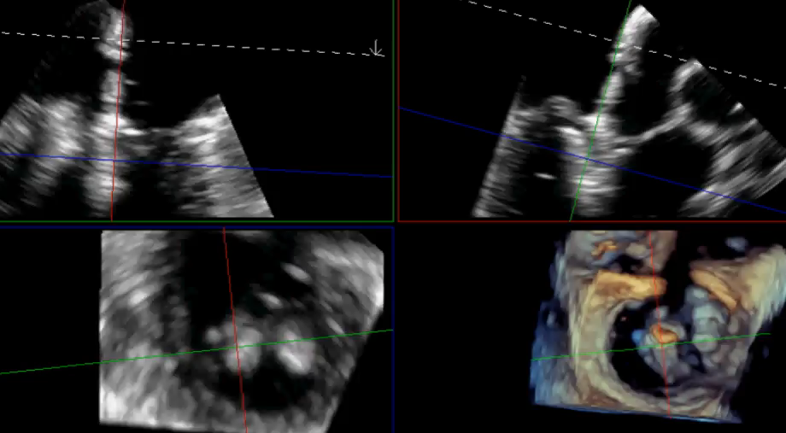
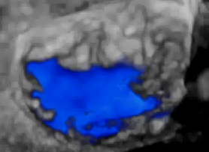
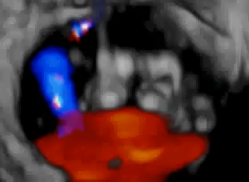
Severe prolapse/Barlow’s

Slide 10
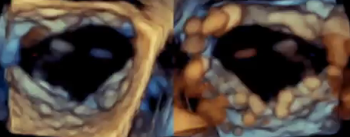
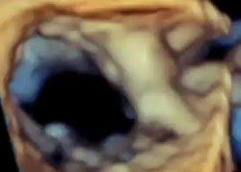
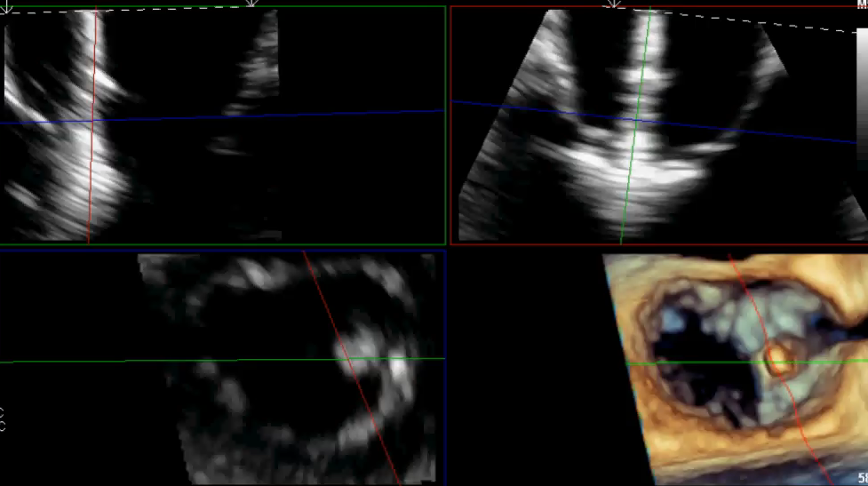
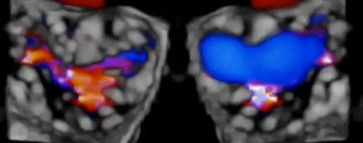
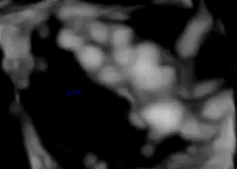
Clefts

Slide 11
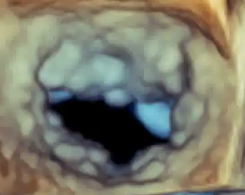
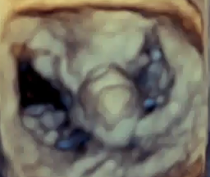
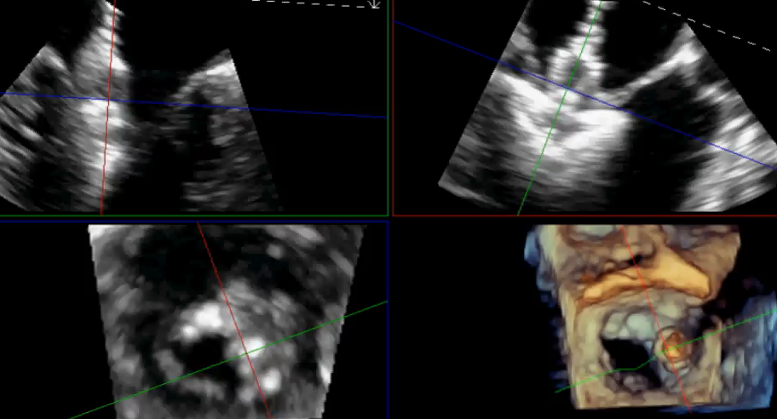
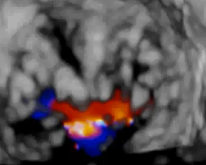
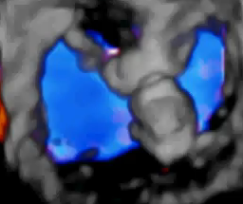
Small(ish) MVA
MVA 2.9cm2
MG 3mmHg (HR 60bpm)

Slide 12
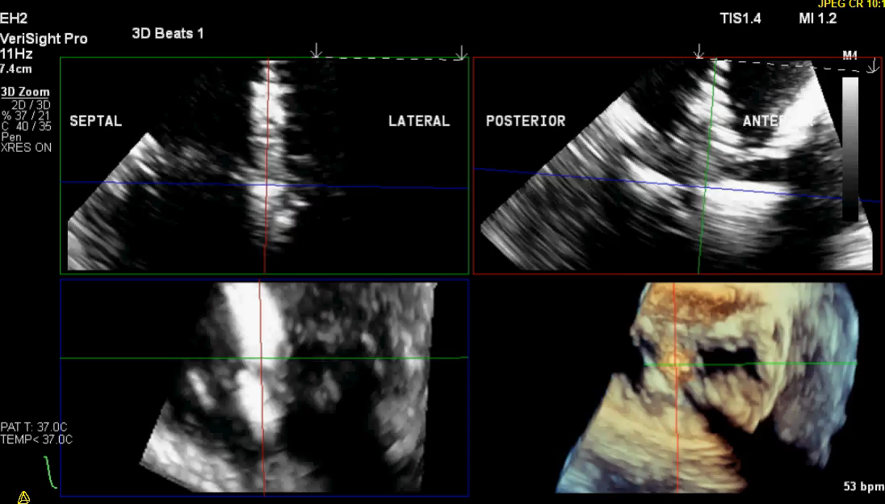
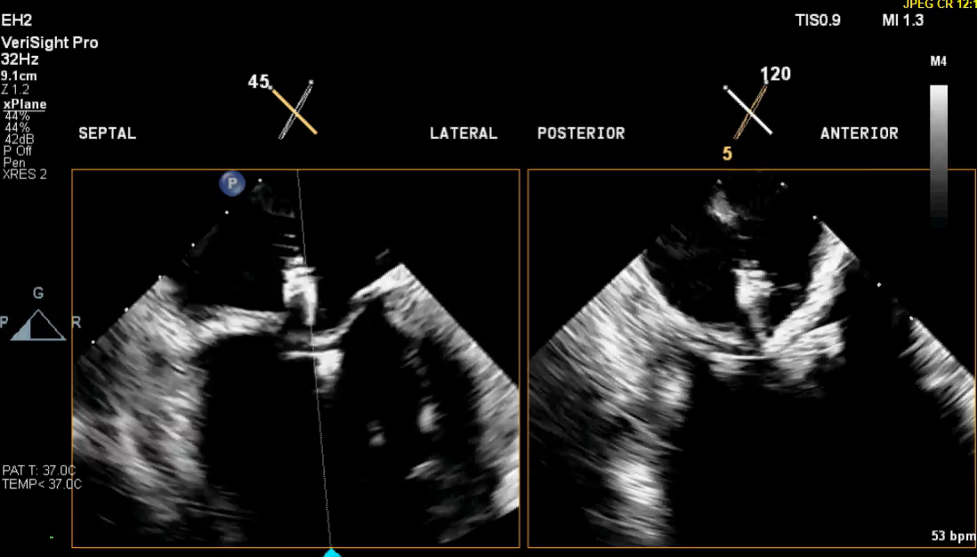
No/poor TEE

Slide 13
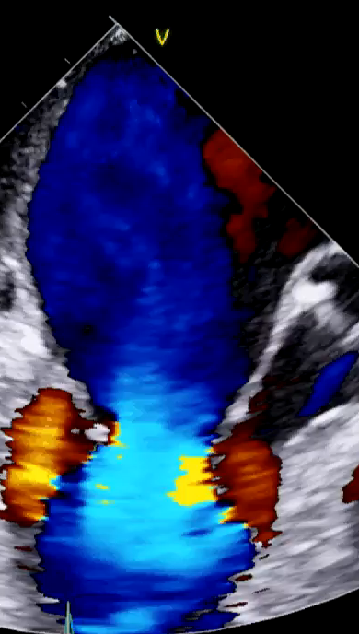
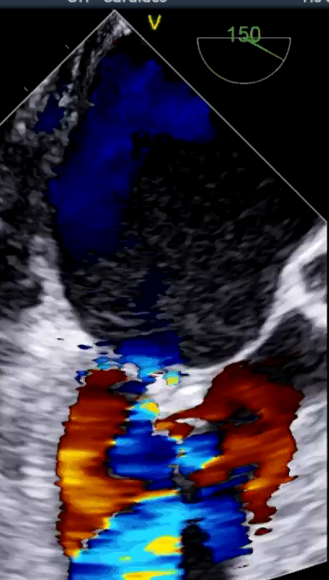
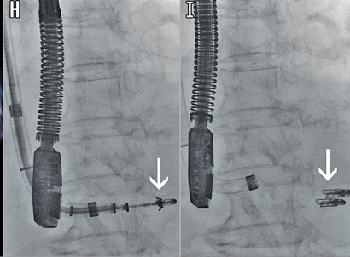
No femoral access
Fam N, Ho EC, et al., EuroIntervention 2017;13:284

Slide 14
What does the data say?

Slide 15
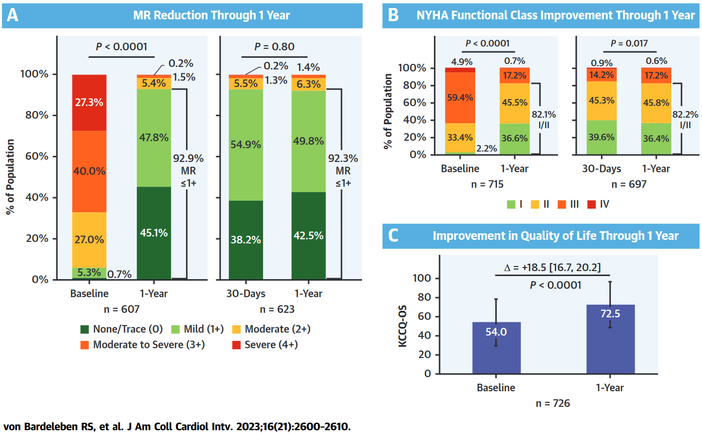
What does that data say? (EXPAND G4)
EXPAND G4
N=1164

Slide 16
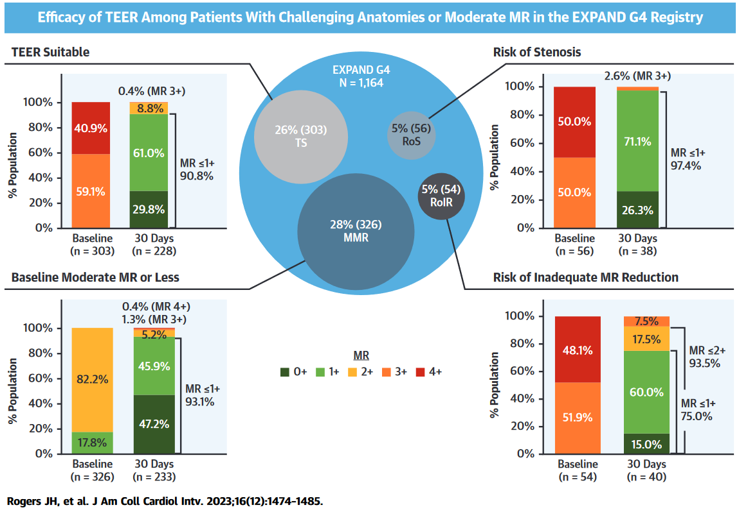
What does that data say? (EXPAND G4)
TEER Suitable
Risk of Stenosis
Risk of Inadequate Reduction
Moderate MR
Rogers J, et al. JACC Card Int 2023; 16:1474

Slide 17
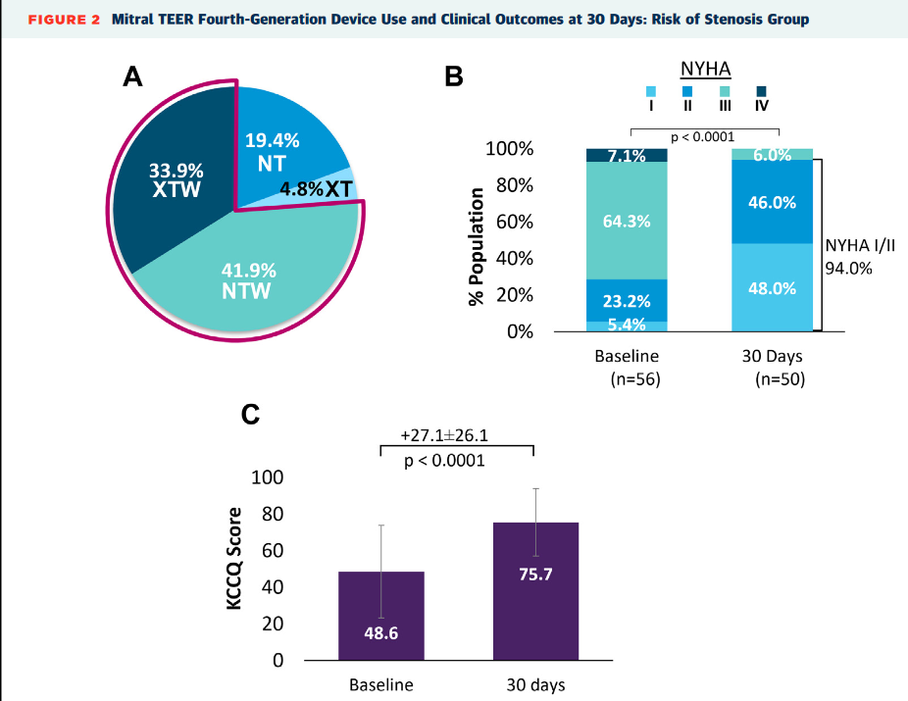
What does that data say? (EXPAND G4)
Risk of Stenosis
One of:
Severe MAC
Severe leaflet calcium
Annuloplasty
MVA <3.5cm2
Mean gradient 4.5 +/- 1.6 mmHg
Median clips = 1
Rogers J, et al. JACC Card Int 2023; 16:1474

Slide 18
What does that data say? (EXPAND G4)
Rogers J, et al. JACC Card Int 2023; 16:1474

Slide 19
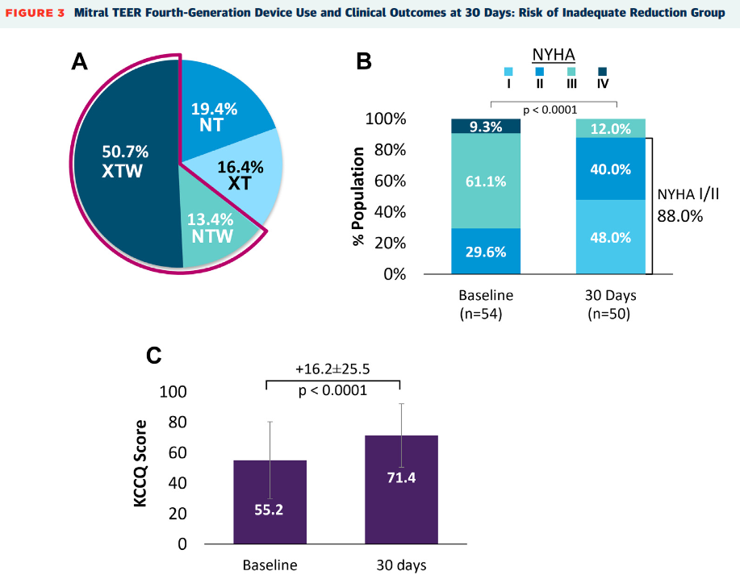
What does that data say? (EXPAND G4)
Risk of Residual MR
One of:
Barlow’s
Bileaflet prolapse/flail
2 significant jets
Large gaps
Minimal leaflet tissue
Significant cleft
Median clips = 2
Rogers J, et al. JACC Card Int 2023; 16:1474

Slide 20
What does that data say? (EXPAND G4)
Rogers J, et al. JACC Card Int 2023; 16:1474

Slide 21
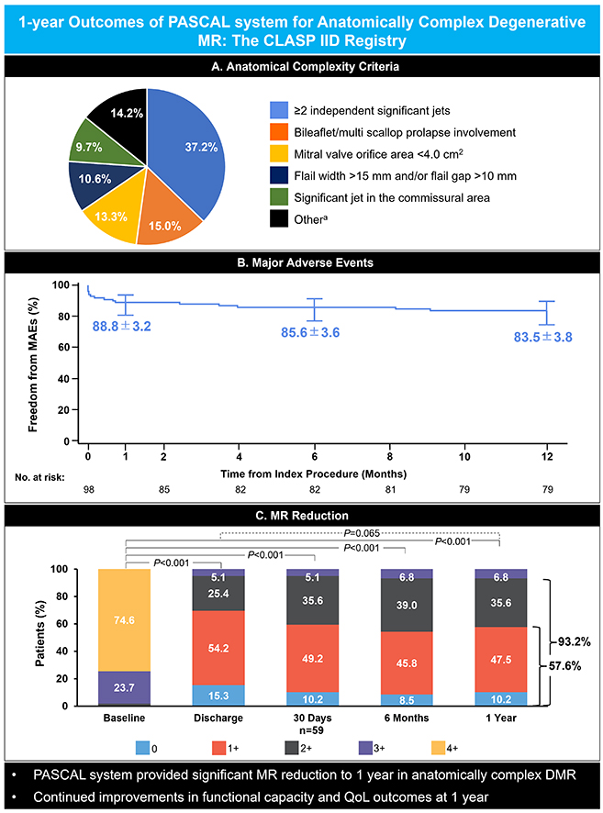
What does that data say? (CLASP IID)
Smith et al., JACC CI 2023; JCIN 7208

Slide 22
What does that data say? (CLASP IID)
Moderate or less
Mild or less
Smith et al., JACC CI 2023; JCIN 7208

Slide 23
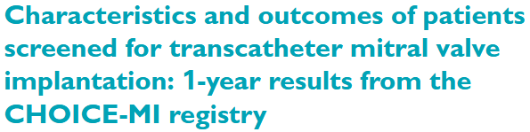
What does the data say? (CHOICE-MI)
n = 767
high-prohibitive surgical risk
suboptimal TEER anatomy
216 had “bailout TEER”
Ben Ali W, et al. EJHF 2022; 24:887

Slide 24
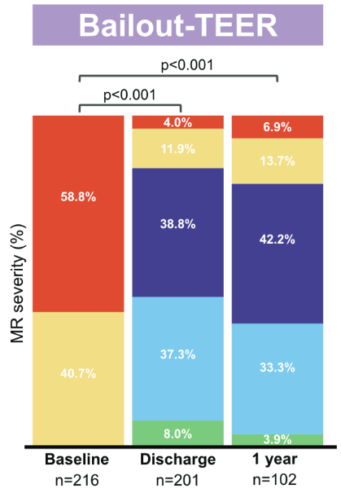
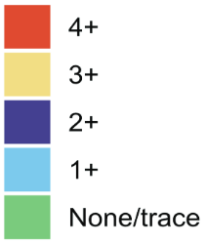
What does the data say? (CHOICE-MI)
Moderate or less
79.4%
Mild/trace
37.2%
Ben Ali W, et al. EJHF 2022; 24:887

Slide 25
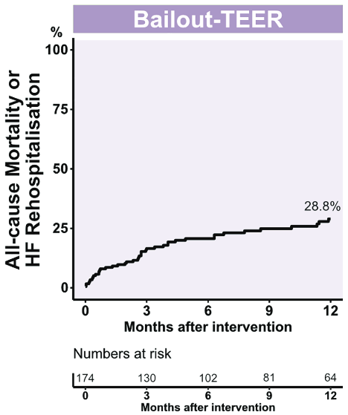
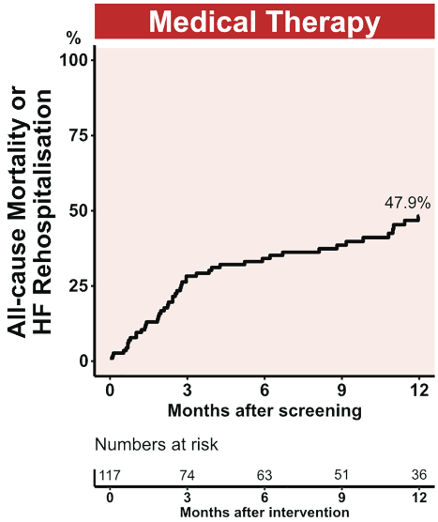
What does the data say? (CHOICE-MI)
Ben Ali W, et al. EJHF 2022; 24:887

Slide 26
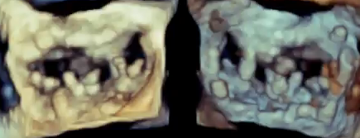
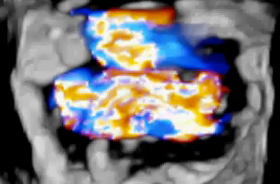
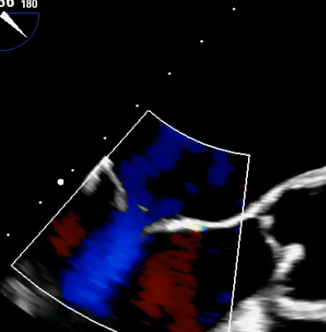
M-TEER unmet needs
Not enough tissue
Leaflet:annulus
Tissue quality
Degenerative
Endocarditis
Clear stenosis/stenosis risk
Rheumatic
Severe MAC/leaflet calcium
From LA
From LV
Residual MVA 2.7cm2
Mean gradient 7mmHg
(HR 83bpm)

Slide 27
Summary
Anatomy treatable by M-TEER continues to expand
Supported by reasonable observational outcomes
There is still an unmet need in truly M-TEER ineligible
Not enough tissue
Poor leaflet quality
Clear stenosis
Thank you!

