Slide 1
Adapting to Change in Structural Heart Disease Training
Michael Mack, MD
Baylor Scott & White Health
Dallas, TX

Slide 2
Conflict of Interest Disclosure
Abbott- Co- PI of COAPT Trial of Abbott Vascular
Medtronic-Study Chair Apollo Trial
Edwards Lifesciences- Co-PI of PARTNER 3

Slide 3
How Have Most Operators and Centers Been Trained in Structural Heart?
Industry courses
Proctors
International meetings- London Valve, PCR, TVT, TCT
OTJ- “On the Job” Training
Non-certified fellowships with variable length and core curriculums

Slide 4
Do We Need Formal “Structured” Training in Structural Heart?
Structural heart is now a “specialty”
Although the current forms of training have served us well until now, future needs are going to require a more focused and comprehensive approach
This isn’t all about TAVR
It’s about
Aortic Valve
Mitral Valve
Tricuspid Valve
LAA
Ascending Aorta
LVOT/HOCM
Etc, etc, etc
MCS

Slide 5
Non-certified Structural Heart Fellowships For Interventional Cardiology in US n=40
Banner | Henry Ford | UNC | Buffalo
Scripps | Minnesota | Rutgers | Case Western
UCLA | Mayo | Hackensack | Lankenau
UCSF | Minneapolis Heart | Lenox Hill | Brown
UCSD | Washington U | Columbia | Houston Methodist
Yale | MMHI | NYU | Baylor SW Plano
Miami | Dartmouth | U Washington | Carrillon
Emory | Duke | Prarie Heart | MGH
Rush | Johns Hopkins | Ochsner | Beaumont
Detroit | Boston U | Maryland | U Massachusetts

Slide 6
Non-certified Structural Heart Fellowships For Cardiac Surgery in US n=10
Brigham & Womens | Medstar
Columbia | NYU
Emory | Penn
Baylor Scott & White Plano | UT Houston
Houston Methodist | University of Virginia

Slide 7
What Is Included in Fellowship Training?
Clinical decision –making (heart team approach) in valve clinics
Shared decision-making with patient
Skills in diagnostic imaging- Echo, CT, MR
Procedural skills
Management of complications
Post procedural care
Intra-procedural imaging skills
Exposure to cardiac surgery procedures for cardiologists
Research opportunities

Slide 8
Structural Heart Fellowships Baylor Scott & White Health-Heart Hospital Plano
Cover Structural Cases (1/2 TAVR Days Weekly)
TAVR Clinic (One Half Day Per Week, Provide Opinion on Surgical/TAVR Candidacy)
Mitral Clinic (One Half Day Per Week)
Valve Service Responsibilities (Consults, Rounding, Discharges, etc)
Attend/Present at Weekly TAVR Meeting
Attend Monthly Mitral Meeting
Surgical High Risk Conference
Weekly Research Meeting
Surgical Cases
Karim Al-Azizi, MD
Interventional
Cardiologist
Anita Krueger, MD
Cardiac Surgeon

Slide 9
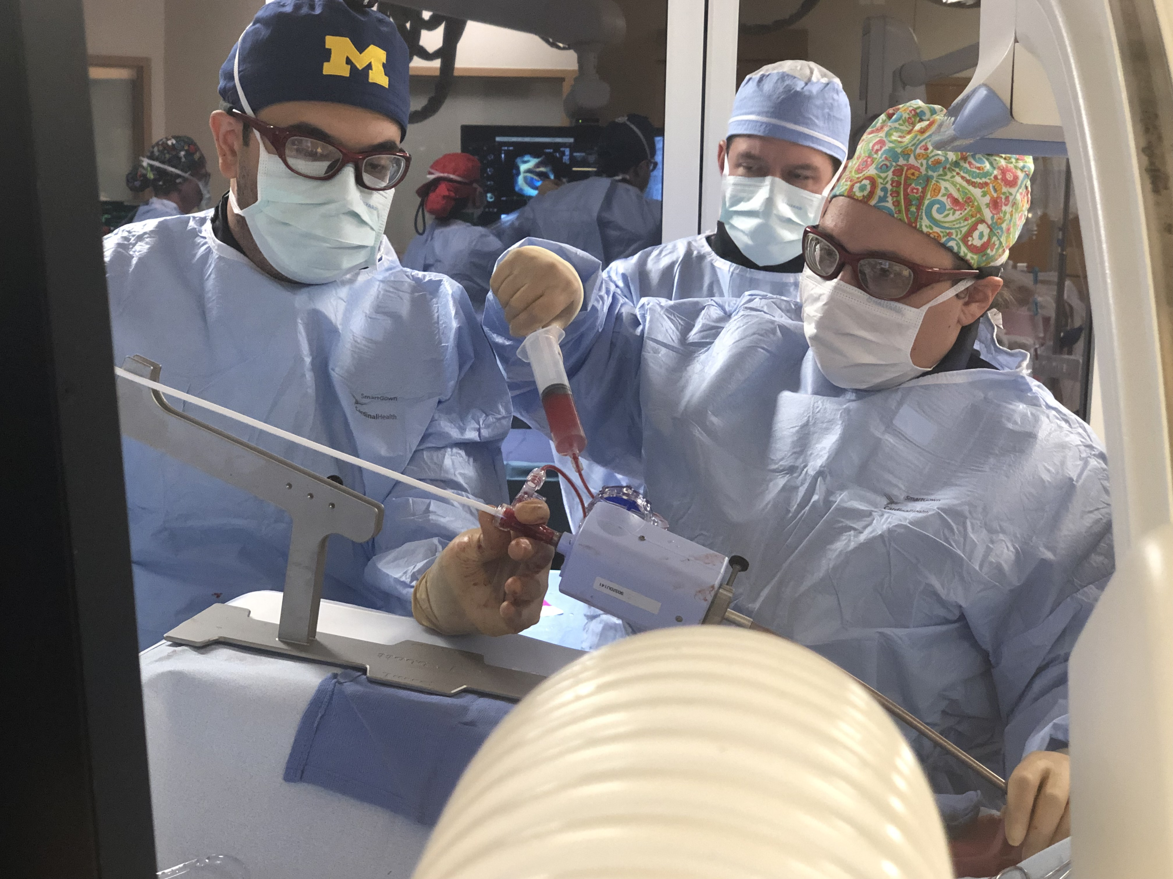
Structural Heart Fellowships Baylor Scott & White Health-Heart Hospital Plano

Slide 10
Structural Heart Fellowship- One Year Case Log
Interventional Cardiologist
Cardiac Surgeon
Total Cases: 273
TAVR: 161
MitraClip: 12
Additional Trans-Septal Punctures: 19
Mitral ViV/ViMAC: 6
BAV: 2
Tricuspid: 3
Surgery-68
Total Cases-436+
TAVR: 200
Watchman: 20
MitraClip: 16
PCI: 200+

Slide 11
Structural Heart Fellowships July 2021 Baylor Scott & White Health-Heart Hospital Plano
Interventional Cardiology
Cardiac Surgery
Imaging-Echo, CT, MRI, Intra-procedural Imaging

Slide 12
Proposed Future Structural Heart Training
One year structural heart fellowship
ACGME certified
Include all aspects of structural heart disease

Slide 13
Proposed ACGME Structural Heart Fellowship for
SURGEON and CARDIOLOGIST
Cons
Pros
Most ambitious
Requires deconstructing current mindset and building from the ground up
Most likely more IC trained than surgeons
Requires extra year of training
Justify IC to train surgeons who may be competition
Surgeons start off behind IC w less wire skills… (but IC start off w less surgical skills… potential trade off)
Limited surgeon involvement
Things are going pretty well right now
Preserves and promotes HEART TEAM
More cross collaboration – possibly the most effective training paradigm
Training would be DISEASE specific (i.e. valve specialists), not just TAVR
Unique paradigm multi-speciality ACGME certified training pathway…
Acceptance: Certificate recognized by cardiologists/surgeons.
Majority of knowledge and skills are common to both

Slide 14
Example of Fellow Rotation Schedule
IC
July | Aug | Sep | Oct | Nov | Dec | Jan | Feb | Mar | Apr | May | June
SH | CS | Cath | SH | SH | SH | Cath | SH | SH | SH | SH | Cath
CS
July | Aug | Sep | Oct | Nov | Dec | Jan | Feb | Mar | Apr | May | June
CS | Cath | SH | SH | SH | SH | CS | SH | SH | SH | SH | CS
Interventionalist
CS: Cardiac Surgery- 3months
Cath: Diagnostic Cath- 1month
SH: Structural Heart- 8 months
Cardiac Surgeon
CS: Cardiac Surgery- 3months
Cath: Diagnostic Cath- 1month
SH: Structural Heart- 8 months

Slide 15
Structural Heart Training Summary
Structural heart disease is now a specialty within interventional cardiology and cardiac surgery
Although training until now has been sufficient, it is time to formalize training with a basic core curriculum and standardized comprehensive approach
Optimal way to preserve and foster the “heart team” approach is with a common fellowship
Myriad of “devilish details” to address including, burden of additional training, crossing departmental structure, financial…

