Slide 1
TAVR Antithrombotics 2020: Still Unresolved Issues
George D. Dangas, MD, MSCAI, FACC, FESC
Professor of Medicine (Cardiology) & Surgery (Vascular)
Icahn School of Medicine at Mount Sinai, New York
Καθηγητής Καρδιολογίας Εθνικού Καποδιστριακού Παν/μίου Αθηνών

Slide 2
Disclosures
Research Grant to Institution:
Abbott, Bayer, Daiichi-Sankyo, Boston Scientific
Consultant/Advisory Board:
Janssen, Boston Scientific, Philips
Common Stock (divested): Medtronic

Slide 3
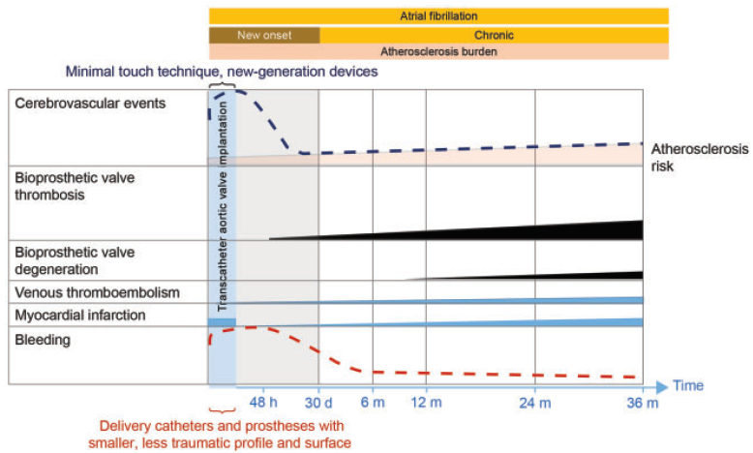
Ischemic and bleeding events peak during the immediate
post-operative period
Vranckx P, Dangas G et.al. European Heart Journal (2017) 38, 3341–3350

Slide 4
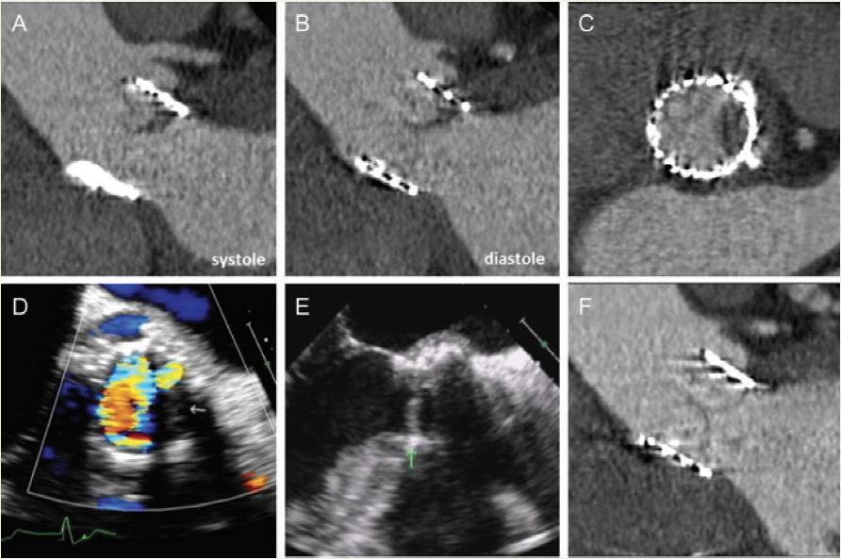
Subclinical reduced leaflet motion
Hypoattenuating structure and thickened leaflets
Mean gradient 9 mmHg
After 10 weeks OAC
G Pache et al. Eur Heart J. 2013; 34:3546

Slide 5
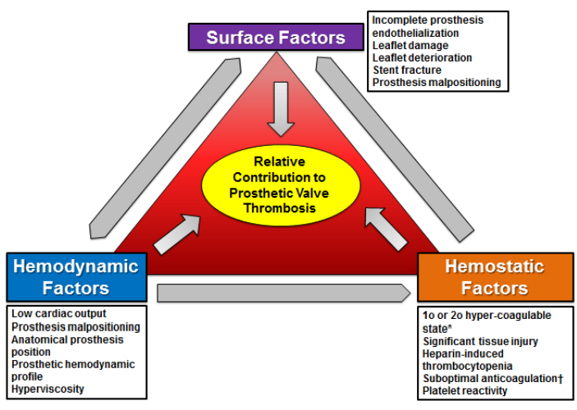
Prosthetic Valve Thrombosis Underlying Pathophysiology
Dangas G, Weitz J, Giustino G, Makkar R, Mehran R. JACC 2016
N.Y.T.V. - 2020

Slide 6
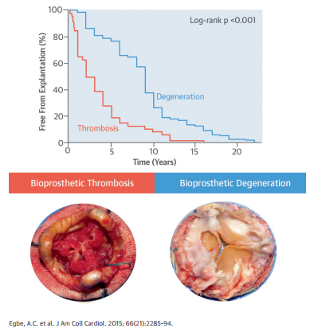
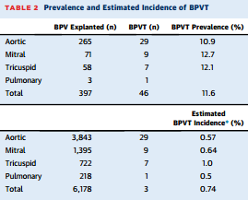
Valve Thrombosis vs. Structural Failure Surgical Bioprosthesis
Multivariate predictors of valve thrombosis:
Paroxysmal AF (OR: 5.19)
Persistent AF with subtherapeutic INR (OR: 3.44)
On VKA with subtherapeutic INR (OR: 7.37)
50% increase in gradient within 5 y (OR: 12.7)
Increased cusp thickness (OR: 12.2)
Abnormal cusp mobility (OR: 6.94)
N.Y.T.V. - 2020
Egbe AC et al J Am Coll Cardiol 2015;66:2285–94

Slide 7
Incidence and Clinical implications of Fluctuating HALT After TAVR/SAVR
PARTNER 3 Low-Risk CT Sub study
TAVR
30 Day
1 Year
HALT
N = 10 (50%)
HALT
N = 20
No HALT*
N = 10 (50%)
HALT
N = 27 (23%)
No HALT
N = 119
No HALT
N = 92 (77%)
Makkar RJ on behalf of the PARTNER 3 Trial Investigators, TCT 2019 and JACC 2020
N.Y.T.V. - 2020

Slide 8
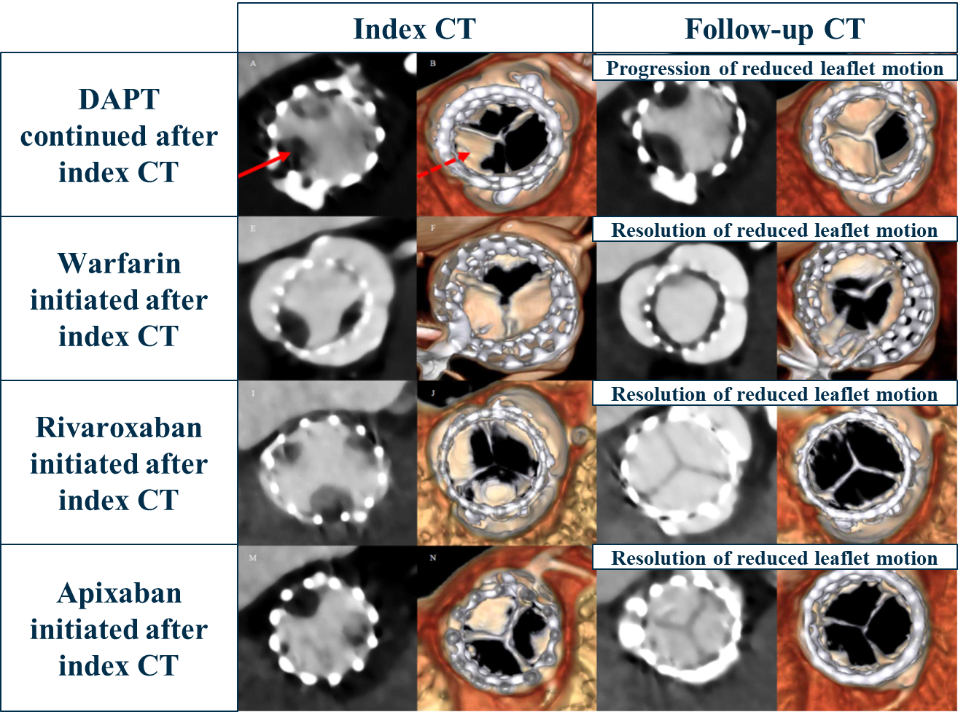
Warfarin/NOAC to prevent/treat HALT/RLM
N.Y.T.V. - 2020
Makkar, TCT 2017

Slide 9
No Underlying OAC indication
N.Y.T.V. - 2020

Slide 10
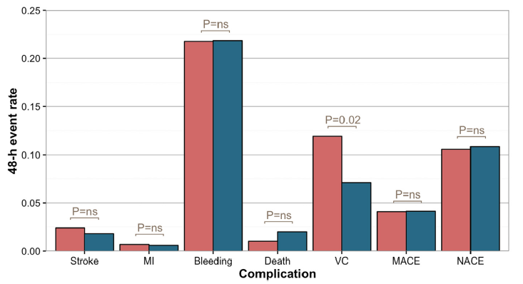
No advantages for clopidogrel loading dose in terms of early ischemic and bleeding outcomes
From the BRAVO-3 Randomized Trial
294 LD vs. 508 NLD
Loading Dose
Variable | OR | P-value
MACE | 0.75 | 0.5
Major VC | 0.91 | 0.67
Bleeding (≥ BARC 3b) | 0.87 | 0.65
No Loading Dose
Observed differences in Major vascular complications were attenuated after adjustment
Results consistent by sensitivity analysis assigning chronic oral clopidogrel preop in the (+) Loading Group
Nijenhuis VJ, Dangas G et al Am J Cardiol. 2019 May 1;123(9):1494-1500.
N.Y.T.V. - 2020

Slide 11
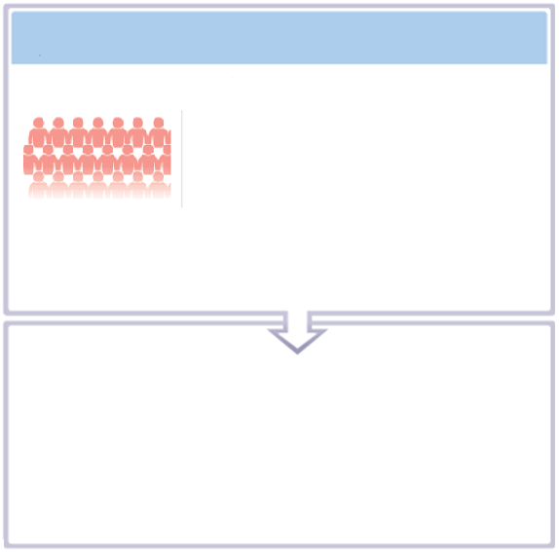
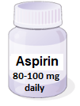
ARTE: 6-month data for aspirin with or without clopidogrel use in TAVI patients without an indication for long-term anticoagulation
with or
without
Patients (N = 222) who underwent transcatheter aortic valve implantation. Excluded those with an indication for long-term oral anticoagulation, had received a drug-eluting stent within 1 year or had major bleeding within 3 months of TAVI
for 3 months (starting before TAVI) with clopidogrel loading dose
and then aspirin alone for duration of trial and thereafter
OR 3.22, 95% CI 1.01-10.34; P = 0.038
Follow-up over a period of 6 months
Aspirin alone
Aspirin + clopidogrel
%Life-threatening or Major Bleeding
% Thromboembolic events (All-cause death, stroke, and myocardial infarction)
12.6%
10.8%
%Life-threatening or Major Bleeding
10.8%
3.6%
3.6%
5.4%
0%
0%
Aspirin
alone
Aspirin + clopidogrel
≤30 days after TAVI
>30 days to 6 months
after TAVI
Aspirin
alone
Aspirin + clopidogrel

Slide 12
Pop-TAVI Randomized Trial - Cohort A
PLANNED TAVI (COHORT A)
RANDOMIZATION 1:1
N=690
PRIOR TO TAVI
ASPIRIN ALONE
N=343
ASPIRIN + 3M CLOPIDOGREL
N=347
12 EXCLUDED
5 Screen failure
4 Died before TAVI procedure
2 TAVI not initiated/completed
1 Withdrew consent
13 EXCLUDED
6 TAVI not initiated/completed
4 Screen failure
3 Withdrew consent
Modified ITT ANALYSIS
N=331
Modified ITT ANALYSIS
N=334
FOLLOW-UP: 1 YEAR
CO-PRIMARY OUTCOMES: 1. All bleeding (VARC-2)
2. Non-procedural bleeding (BARC)
CO-SECONDARY OUTCOMES: 1. CV mortality, non-procedural bleeding, stroke, or MI
2. CV mortality, ischemic stroke, or MI
Jorn Brouwer, Jurrien ten Berg, et al; ESC 2020
Notes:
The flowchart is shown on this slide.
In total 690 patient with a planned were randomized prior to TAVI, to either aspirin alone or aspirin plus clopidogrel follow by aspirin alone.
On the left side the aspirin alone group, 343 patients were randomized to aspirin alone, and after exclusion 331 were included in the modified intention-to-treat analysis
On the right side the aspirin plus clopidogrel group, 347 patients were randomized to aspirin plus 3 months clopidogel, and after exclusions, 334 were included in the modified intention-to-treat analysis
Follow-up was 1 year.
The co-primary outcomes were All bleedings according to VARC-2 and non-procedural bleeding according to BARC
The co-secondary outcomes consisted of the composite CV mortality, non-procedural bleeding, all-cause stroke, or MI and the composite of CV mortality, ischemic stroke, or MI

Slide 13
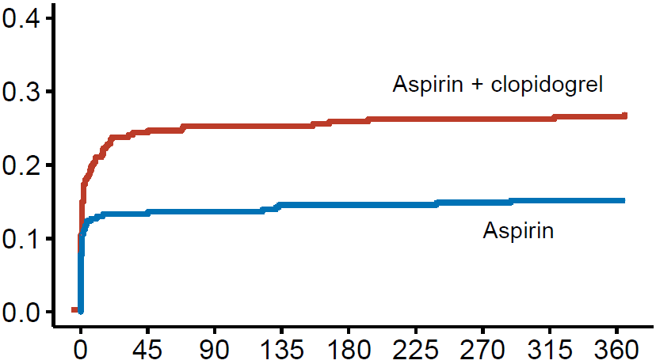
All Bleeding
Pop-TAVI Randomized Trial - Cohort A
26.6%
15.1%
RR 0.57
95% CI 0.42 to 0.77
P = 0.001
Days since TAVI−procedure
Jorn Brouwer, Jurrien ten Berg, et al; ESC 2020
Notes:
The primary outcome all bleeding is shown on this slide.
All bleeding occurred in 15,1% of patients on aspirin alone and 26,6% of patients receiving aspirin plus clopidogrel, and was significantly reduced with a aspirin alone strategy, with a risk ratio of 0,57 and a p-value of 0.001

Slide 14
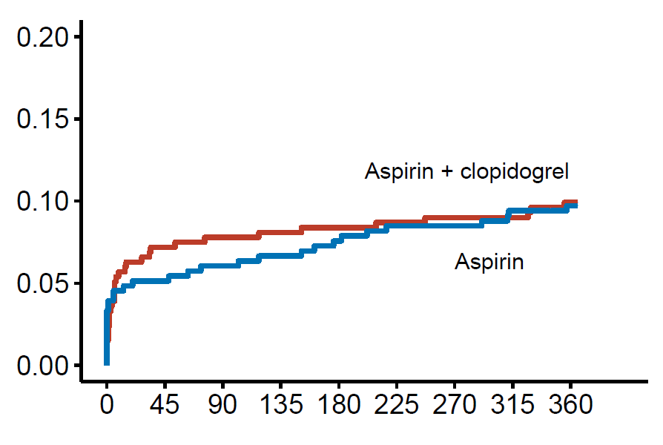
CV Mortality, Ischemic Stroke, MI
Pop-TAVI Randomized Trial - Cohort A
9.9%
RR 0.98
95% CI 0.62 to 1.55
-0.2% (-4.7 to 4.3)
Non-inferiority margin +7.5%
P = 0.04 (noninferiority)
P = 0.93 (superiority)
9.7%
Days since TAVI−procedure
Jorn Brouwer, Jurrien ten Berg, et al; ESC 2020
Notes:
The second secondary outcome, a composite of CV mortality, ischemic stroke, or MI is shown on this slide and occurred in 9.1% of patients receiving aspirin alone and in 9.9% of patients receiving aspirin plus clopidogrel, with a risk ratio of 0.98 and met the criteria for non-inferiority of aspirin alone with a absolute difference of -8.2 percent and a p-value of 0.04, but not for superiority.

Slide 15
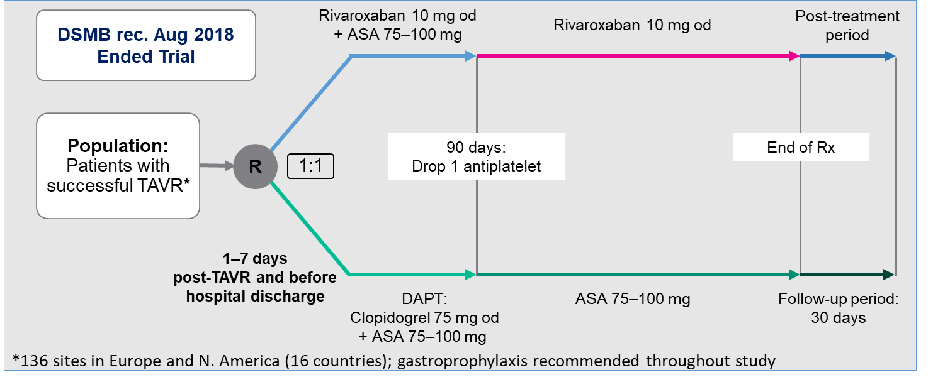
Global PIs G. Dangas and S. Windecker
Official study title: Global Study Comparing a Rivaroxaban-Based Antithrombotic Strategy to an Antiplatelet-Based Strategy After Transcatheter AortIc Valve Replacement to Optimize Clinical Outcomes
Primary Efficacy Endpoint
Composite: Death-Stroke-MI-Symptomatic Valve Thrombosis-Systemic Thromboembolism-Major VTE
Windecker S et al, Am Heart J 2017:184:81–87
N.Y.T.V. - 2020

Slide 16
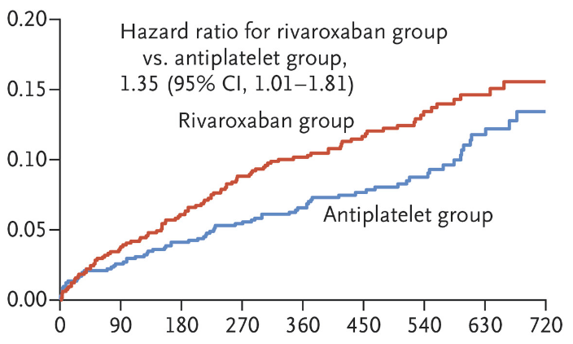
A Randomized Controlled Trial of Rivaroxaban after TAVR
Death, Stroke, MI, symptomatic valve thrombosis, PE, DVT, or systemic embolism
Dangas GD et al N Engl J Med. 2020 and AHA 2019.
N.Y.T.V. - 2020

Slide 17
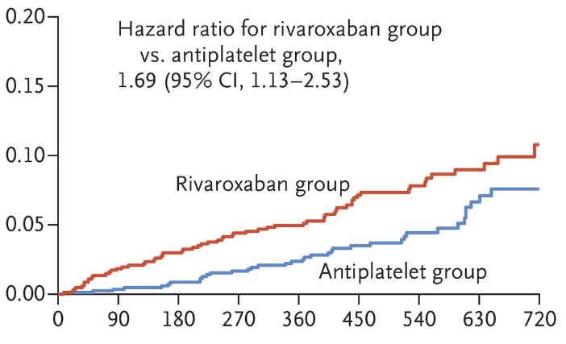
Increased mortality in the Rivaroxaban arm
Death from any cause
Dangas GD et al N Engl J Med. 2019 and AHA 2019
N.Y.T.V. - 2020

Slide 18
Bleeding rate post TAVR
Dangas GD et al N Engl J Med 2019 2020 and AHA 2019
N.Y.T.V. - 2020

Slide 19
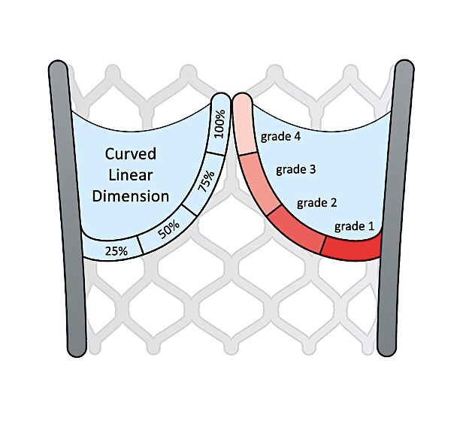
Reduced leaflet motion
Grade 0: normal/unrestricted
Grade 1: minimally restricted (<25%)
Grade 2: mildly restricted (25-50%)
Grade 3: moderately restricted (50-75%)
Grade 4: largely immobile (>75%)
De Backer O, Dangas GD, Jilahawi H, et al AHA 2019 and NEJM 2020
N.Y.T.V. - 2020

Slide 20
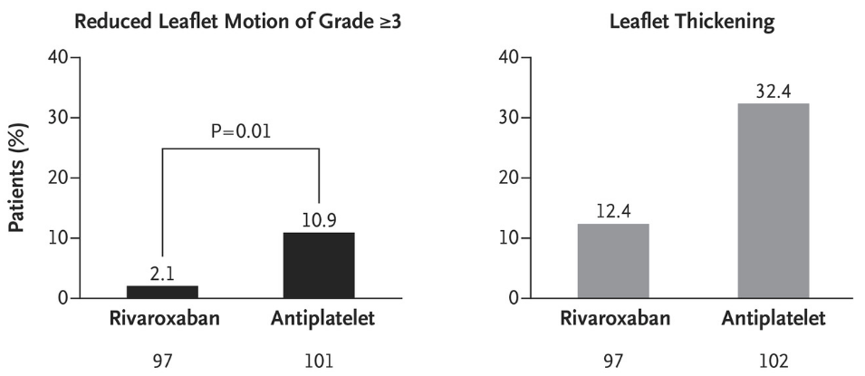
Leaflet Motion after TAVR
Rivaroxaban was effective in reducing the incidence of Reduced Leaflet Motion and Leaflet Thickening but the potential benefit was attenuated by the large number of bleeding complications
De Backer O, Dangas GD, Jilahawi H, et al AHA 2019 and NEJM 2020
N.Y.T.V. - 2020

Slide 21
N.Y.T.V. - 2020
Collet et al., Am Heart J, 2018 Jun;200:44-50.

Slide 22
Underlying OAC indication
N.Y.T.V. - 2020

Slide 23
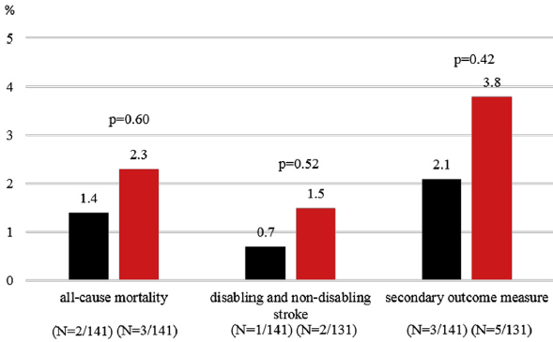
Non-Randomized Clinical Outcomes NOAC vs. VKA
30-Day Clinical Outcomes
12-month Clinical Outcomes
The early safety endpoint at 30 days was significantly less frequent in patients treated with apixaban, at 13.5% compared with 30.5% (p < 0.01)
N.Y.T.V. - 2020
Seeger J, Wohrle J et al J Am Coll Cardiol Intv 2017;10:66–74

Slide 24
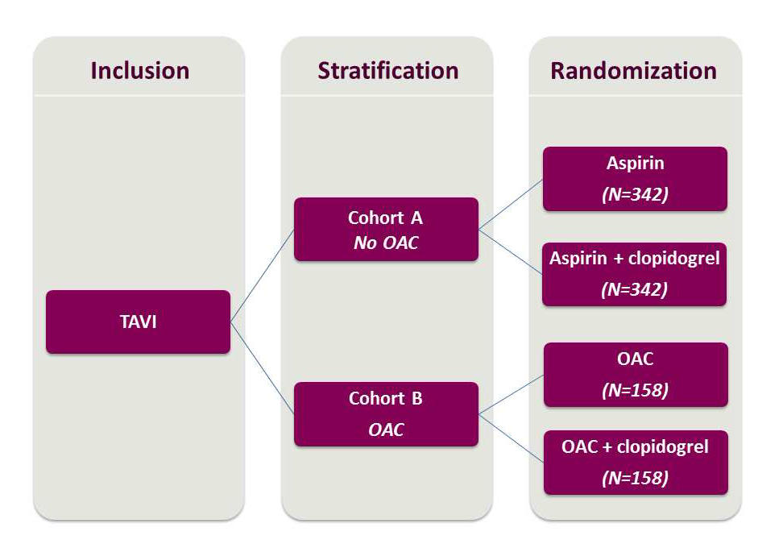
POPULAR TAVI trial Design in 2 Cohorts (on/off OAC)
Patients with a long-term OAC indication
Nijenhuis VJ, ten Berg J et al. Am Heart J. 2016 Mar;173:77-85.
N.Y.T.V. - 2020

Slide 25
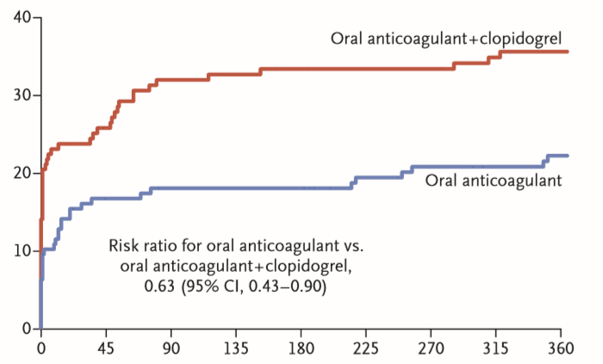
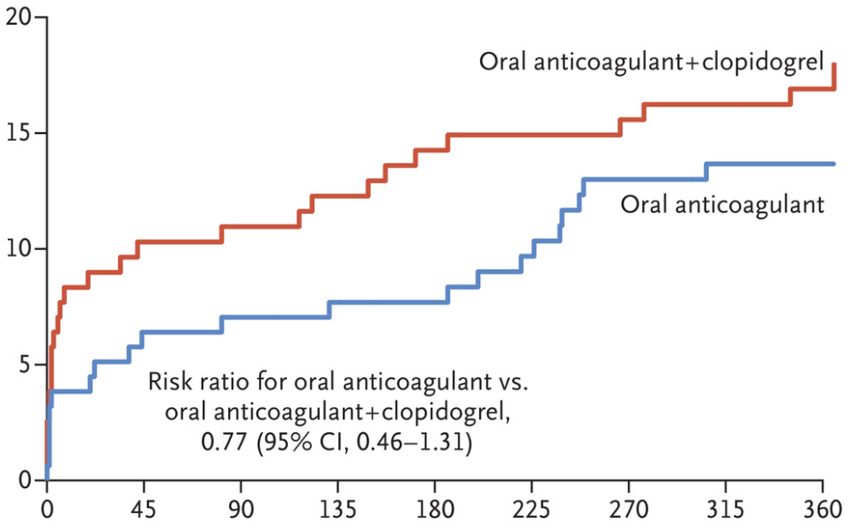
Pop-TAVI Cohort B: Ischemic and Bleeding outcomes
Primary Bleeding Endpoint
Ischemic composite of CV death, ischemic stroke, or MI
Clopidogrel administration on top of OAC increased bleeding without providing ischemic benefit
Most TAVI performed on uninterrupted OAC
Nijenhuis VJ, ten Berg J et al NEJM 2020 Apr 30;382(18):1696-1707.
N.Y.T.V. - 2020

Slide 26
ENVISAGE-TAVI AF trial
PIs: G. Dangas, N. van Mieghem
Results at ESC/AHA 2021
Total n=1427 patients enrolled
enrollment finalized January 2020
Follow-up ends December 31, 2020
N.Y.T.V. - 2020
Van Mieghem NM et.al. Am Heart J. 2018 Nov;205:63-69.

Slide 27
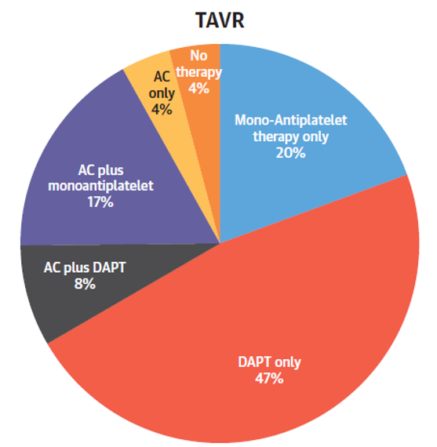
Additional evidence and appropriate guideline recommendations are urgently required
PARTNER RCTs and nonrandomized registries
Chakravarty T et.al. J Am Coll Cardiol. 2019 Sep 3;74(9):1190-1200.
N.Y.T.V. - 2020

Slide 28
Conclusions
The incidence of leaflet thrombosis post-TAVR is high but its clinical implications are not well understood.
No immediate Stroke/TIA risk
? Contribution to Limited/shorter Valve Durability
Clopidogrel loading before TAVR is associated with more bleeding and vascular complications without obvious benefits in stroke prevention.
In GALILEO trial Rivaroxaban was associated with increased mortality despite reducing the incidence of Reduced Leaflet Motion and Leaflet Thickening by all 4DCT-imaging definitions.
Among Patients with A-fib OAC monotherapy was shown to be superior to OAC + clopidogrel in the POPULAR TAVI trial.
With the caveat that most TAVI performed on uninterrupted OAC and most outcome differences occurred in-hospital
Additional LARGE-SCALE randomized evidence basis is required to properly inform guideline recommendations!
N.Y.T.V. - 2020

